Slide 1
CSC 578 Neural Networks and Deep Learning
Fall 2018/19
2. Backpropagation
(Some figures adapted from NNDL book)

Slide 2
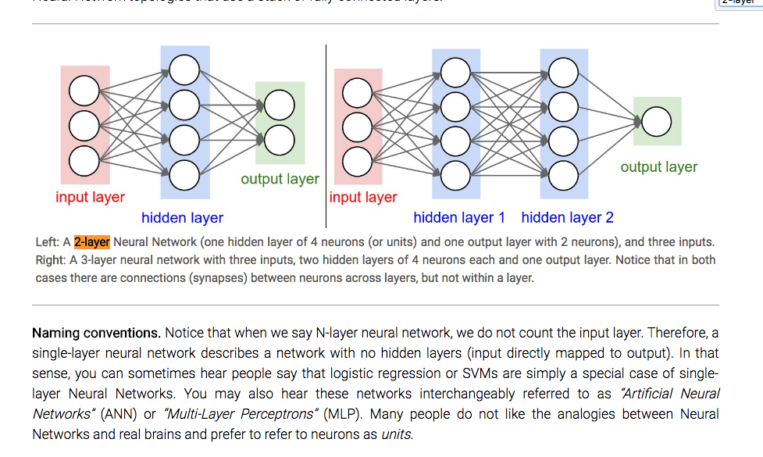
0. Some Terminologies of Neural Networks
“N-layer neural network” – By naming convention, we do NOT include the input layer because it doesn’t have parameters.
Size of the network – usually indicated by the number of nodes in each layer, starting from the input layer. e.g. [3,4,4,1].
Hyper-parameters – Parameters in the network/model for which the values can be set by passing in (from outside; e.g. learning rate η), rather than parameters whose values are determined and controlled internally in the algorithm..

Slide 3
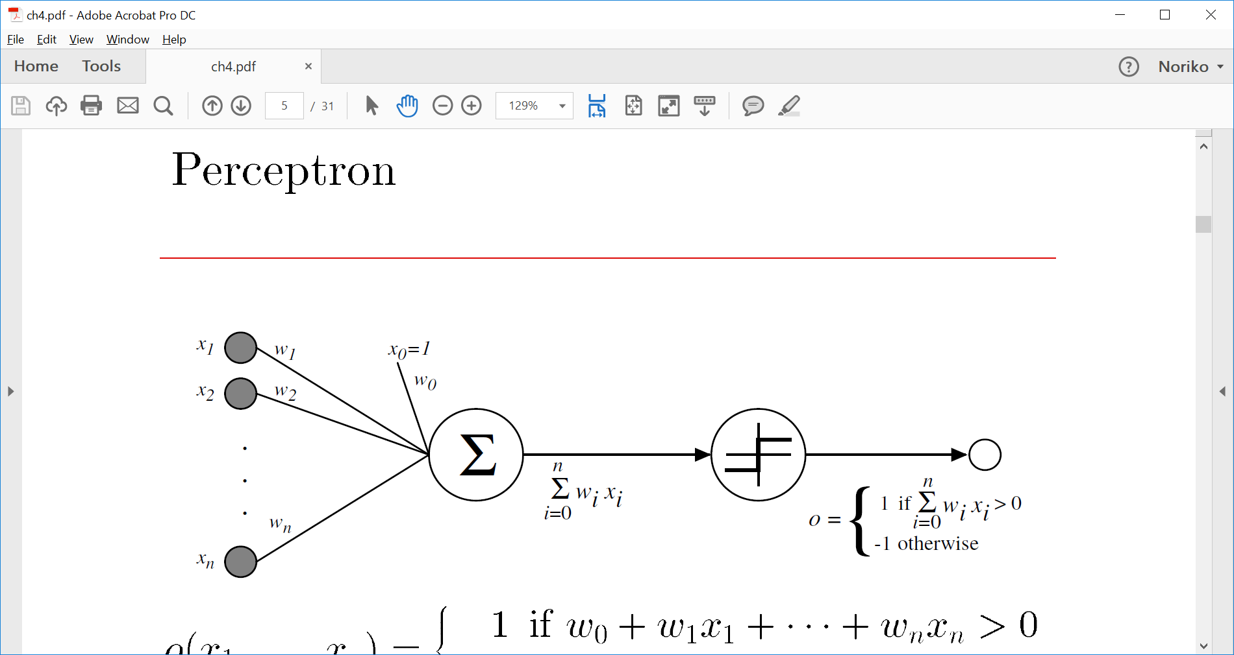
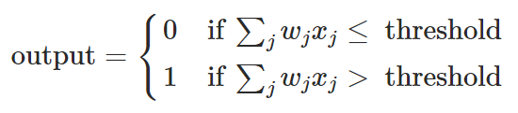
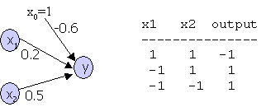
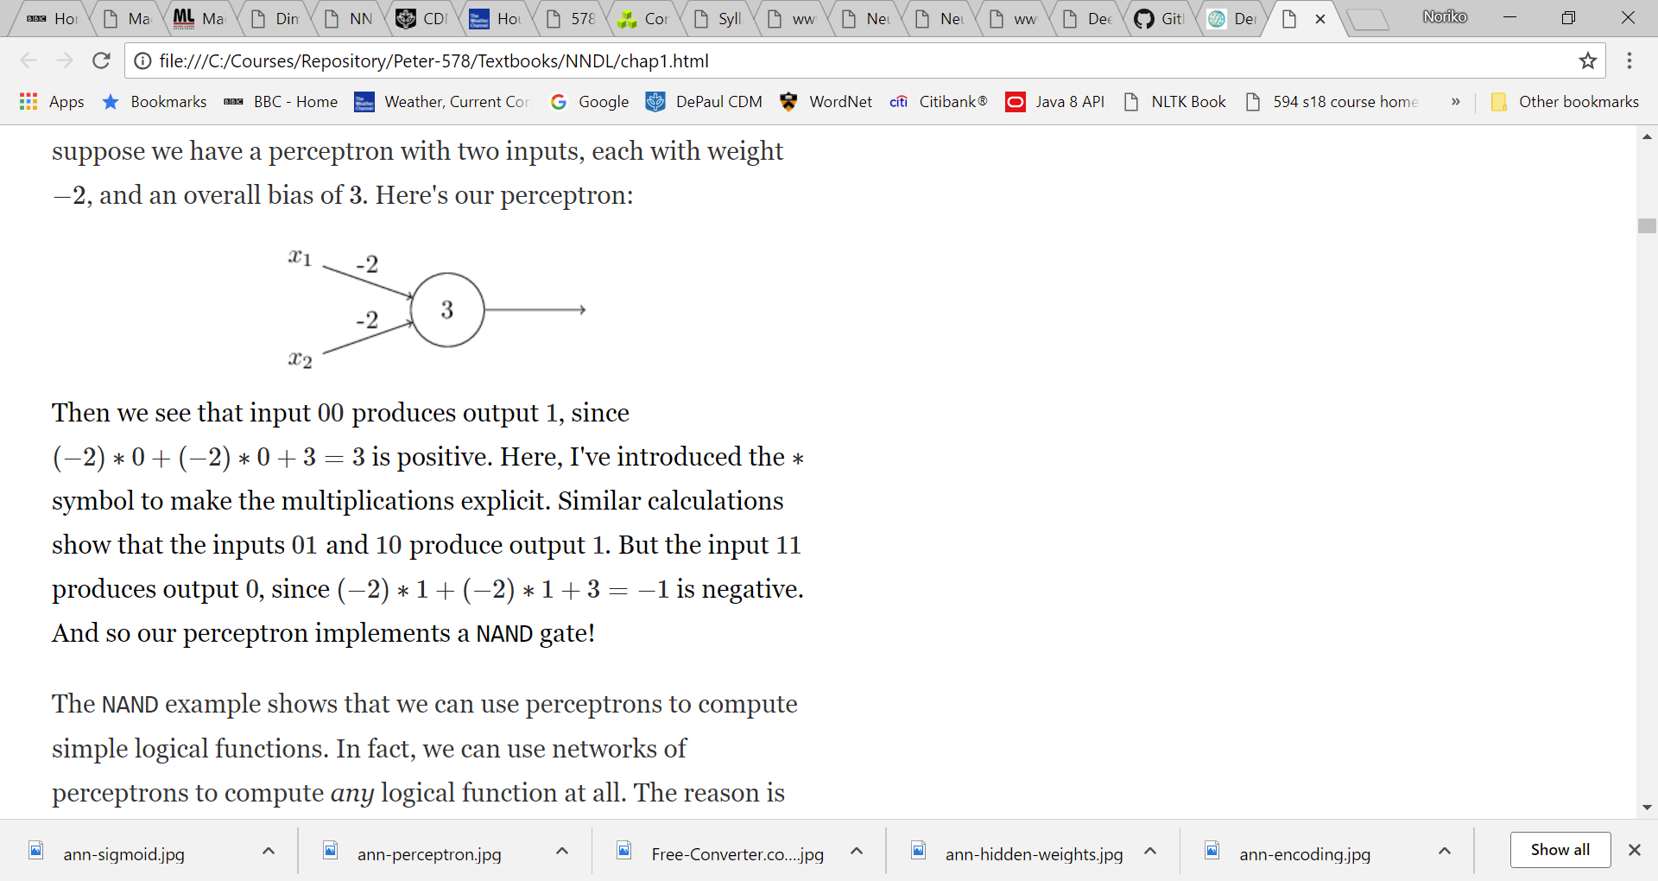
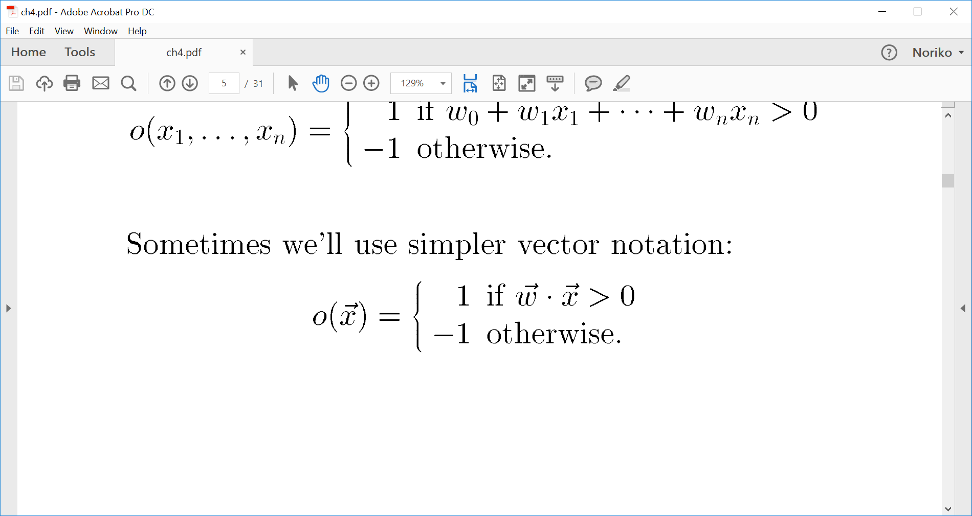
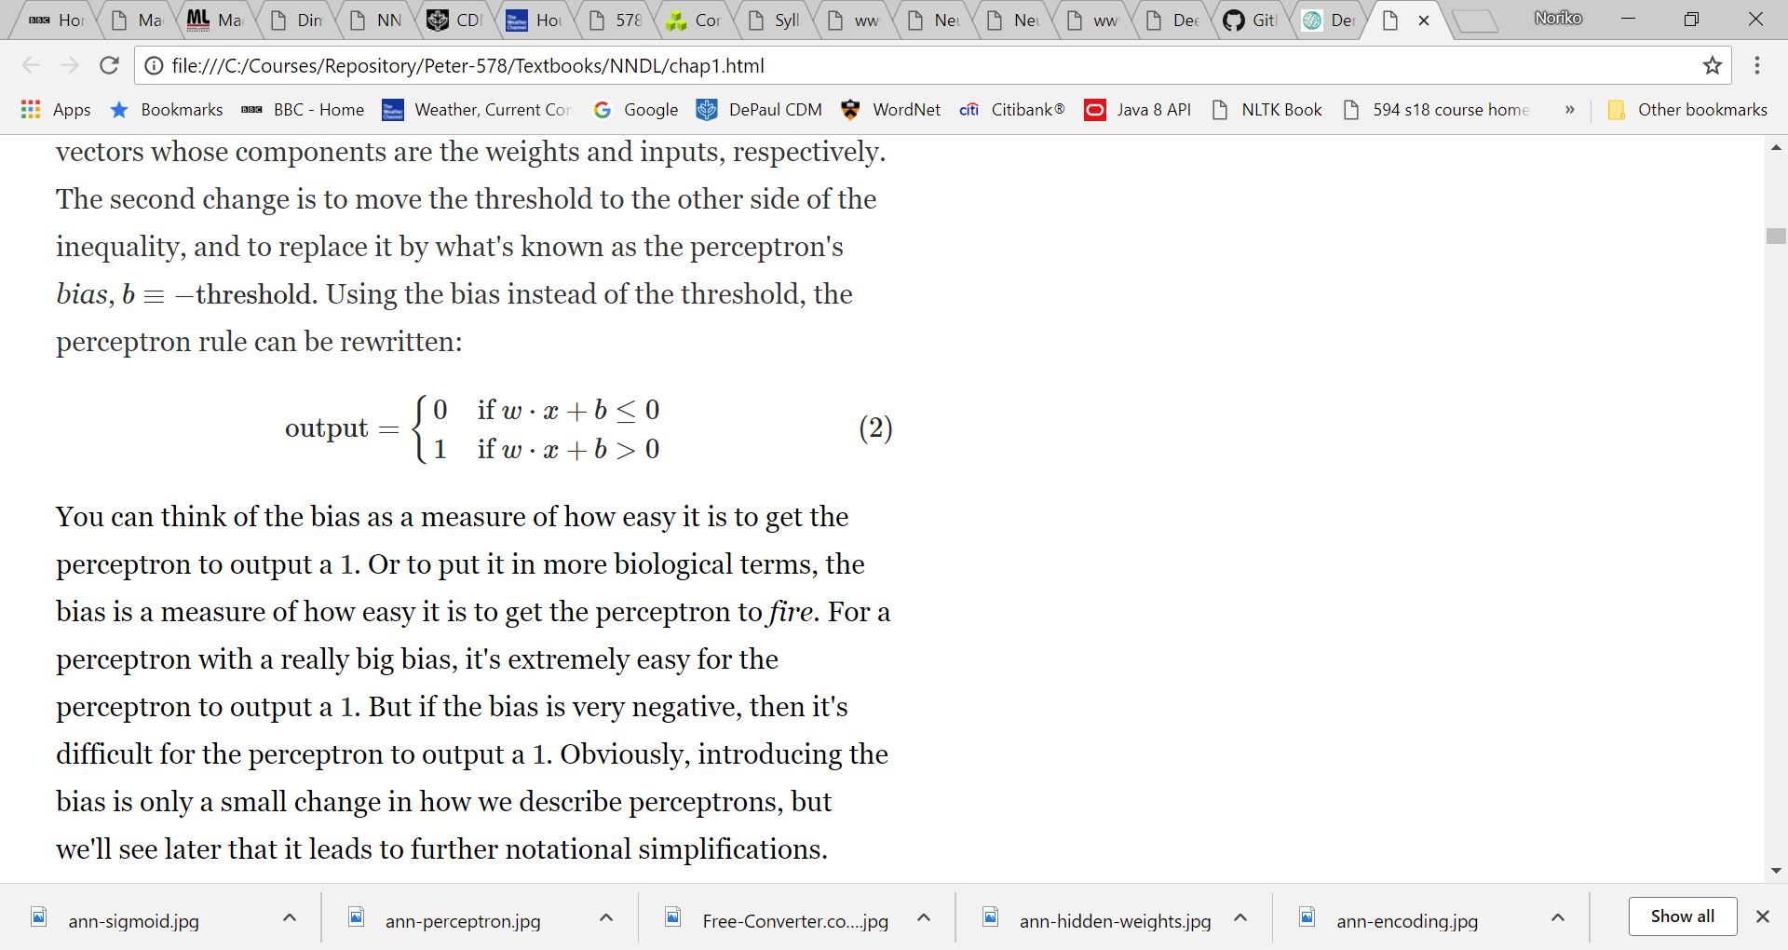
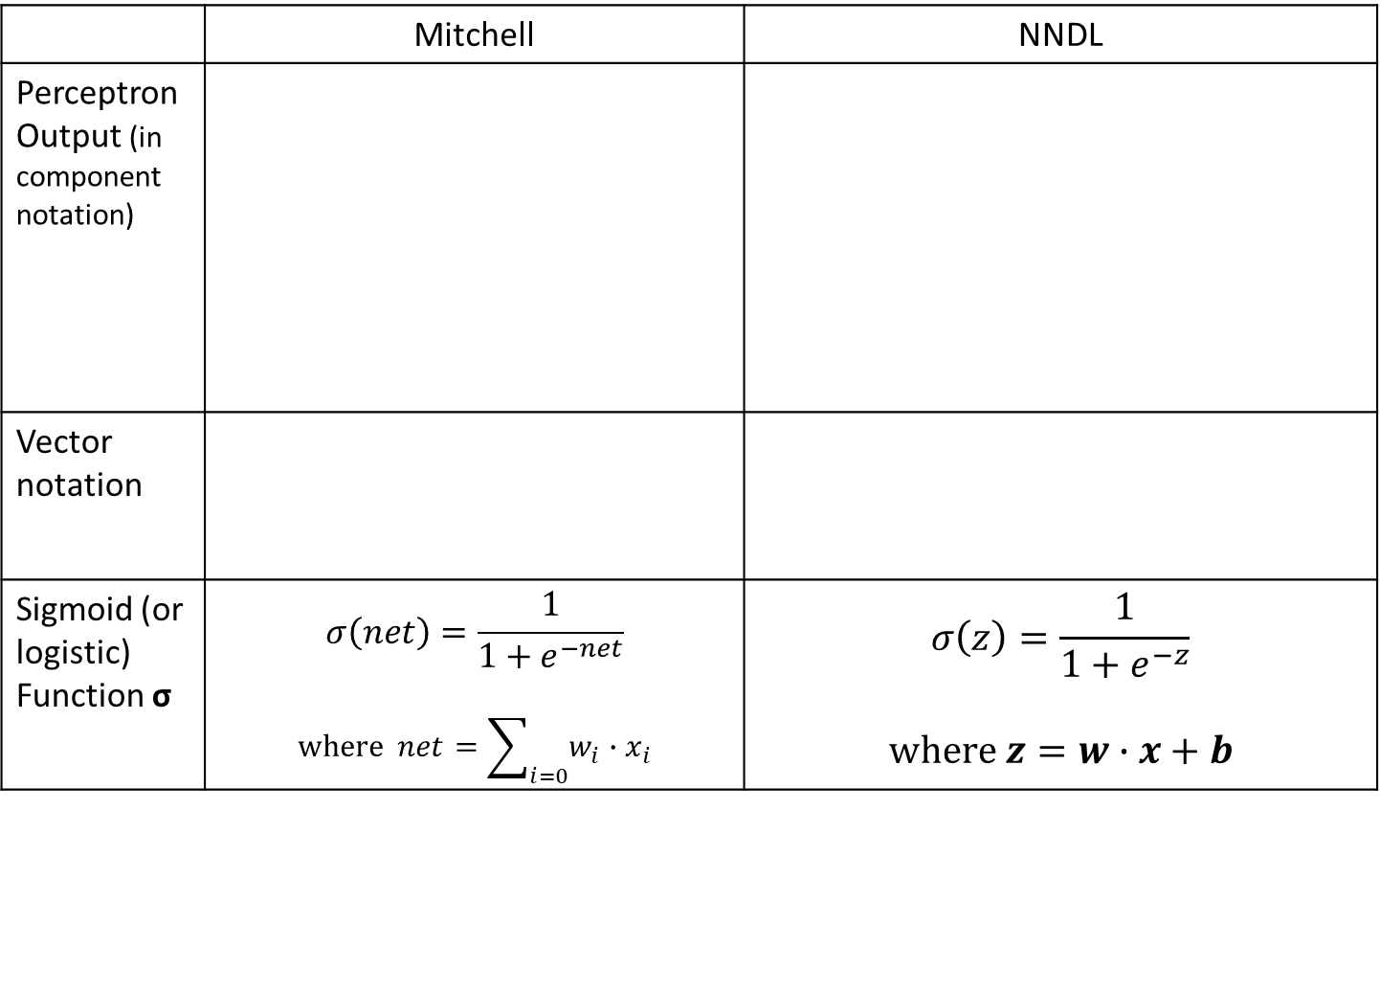
1. Notations in the NNDL book
Differences in the notations between Mitchell’s and NNDL (ch 1)
 | Mitchell | NNDL
Perceptron Output (in component notation)
Vector notation
Sigmoid (or logistic) Function σ | $$σ\left(net\right)=\frac{1}{1+e^{−net}}$$ $$\text{where} net=\sum_{i=0}{w_{i}∙x_{i}}$$ | $$σ\left(z\right)=\frac{1}{1+e^{−z}}$$ $$\text{where} z=w∙x+b$$
where b is a bias, and b = -threshold

Slide 4
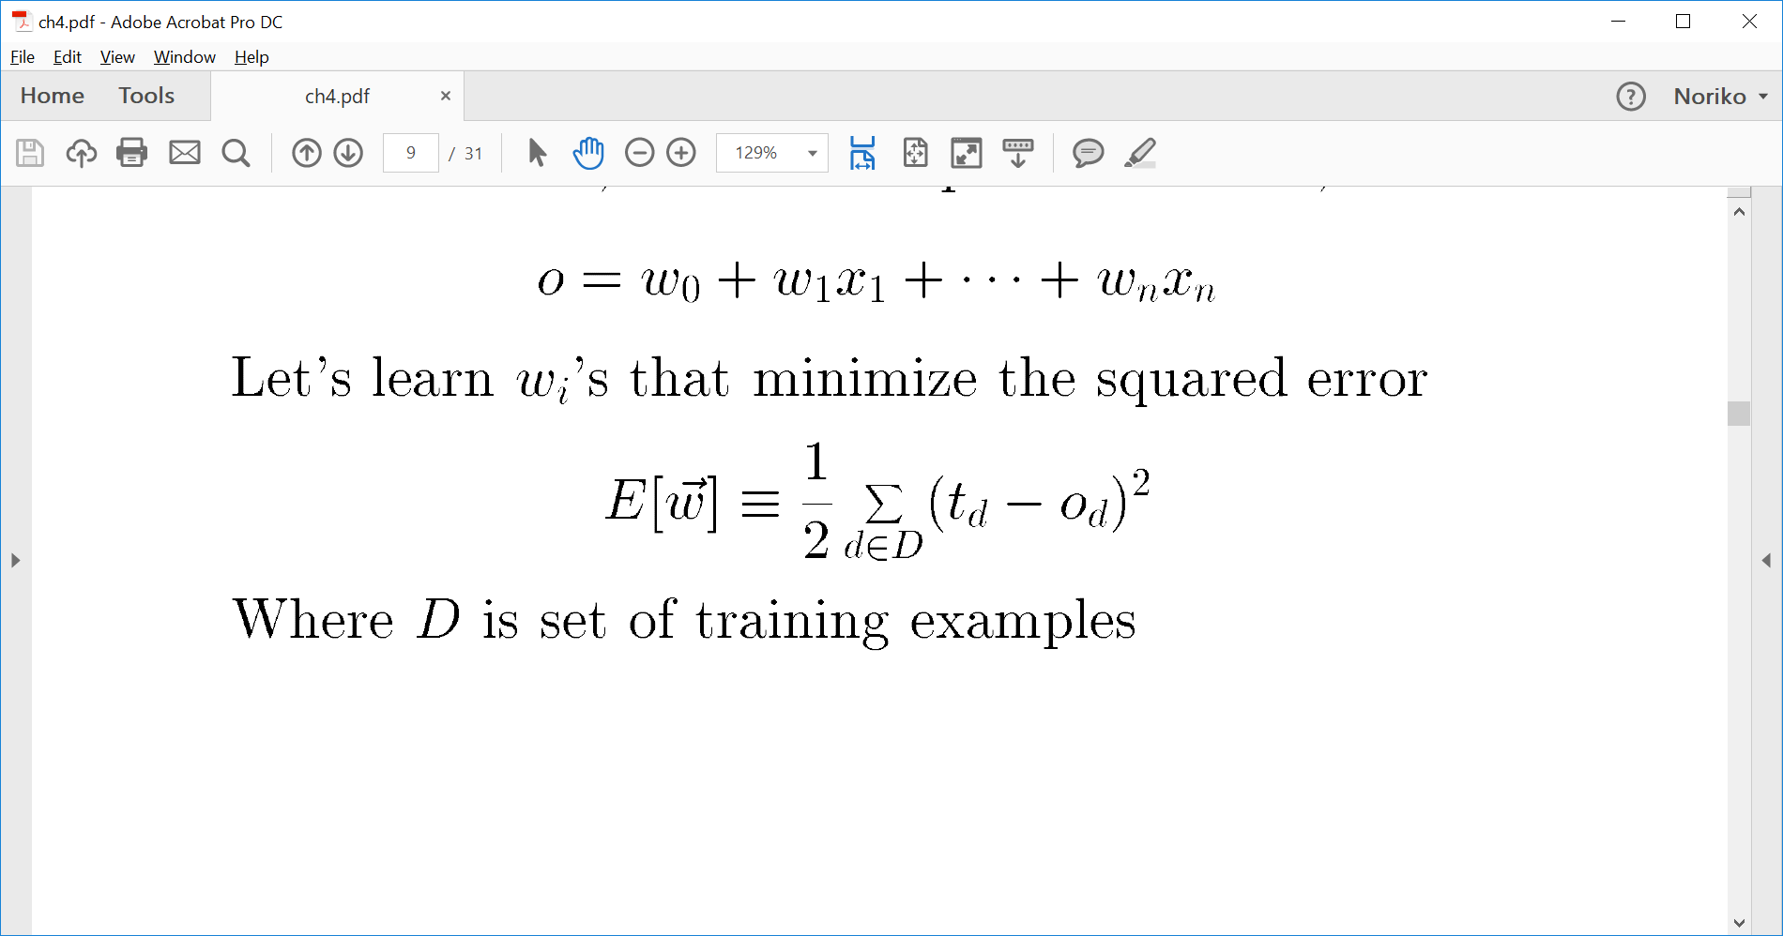
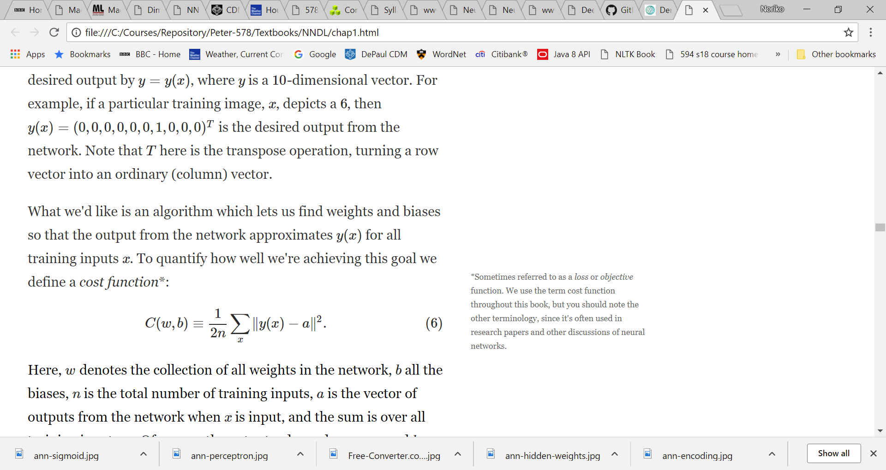
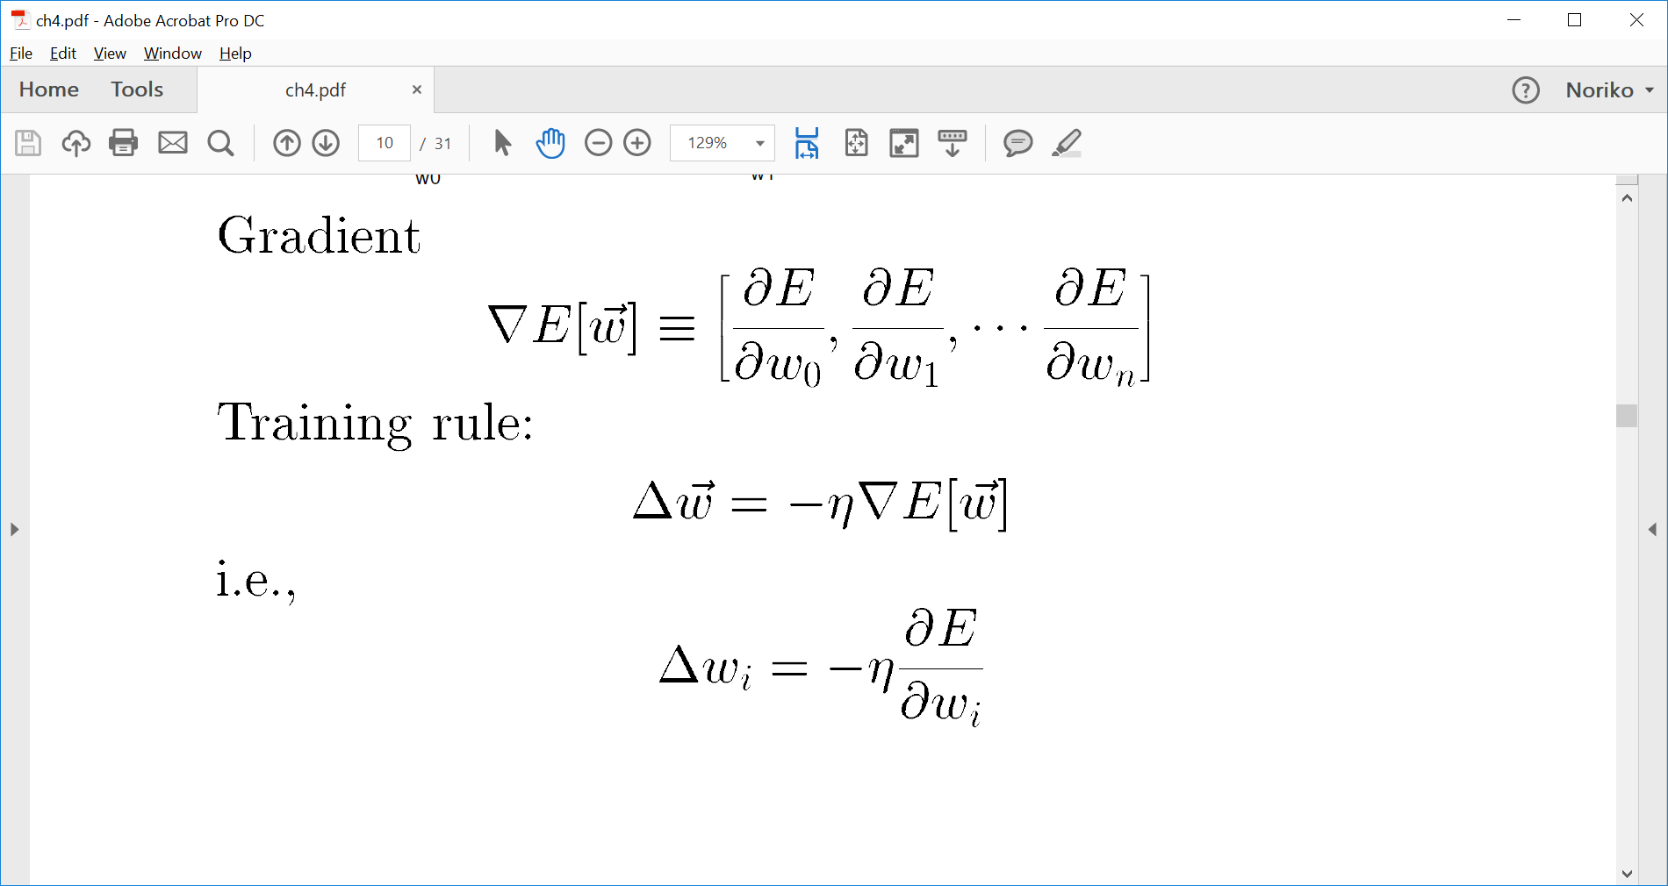
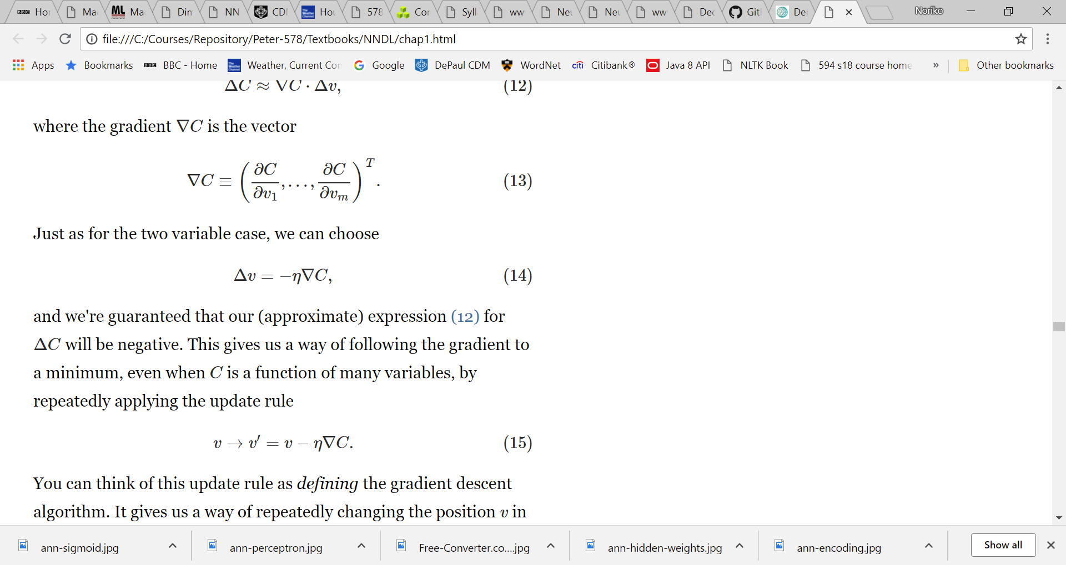
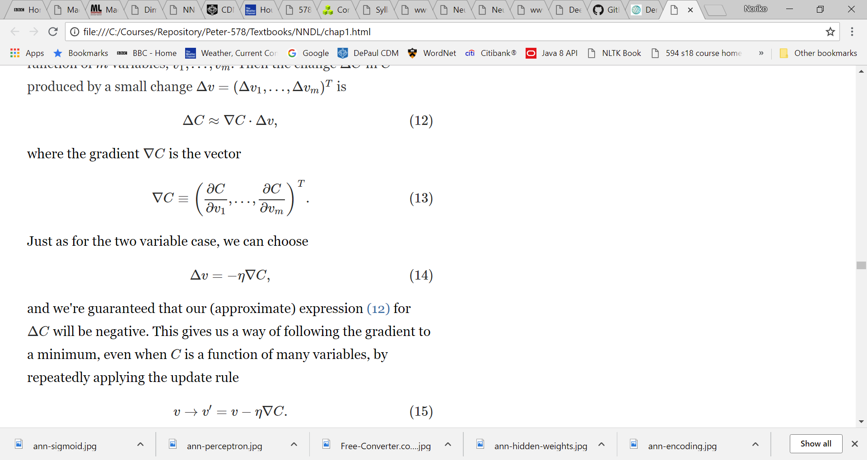
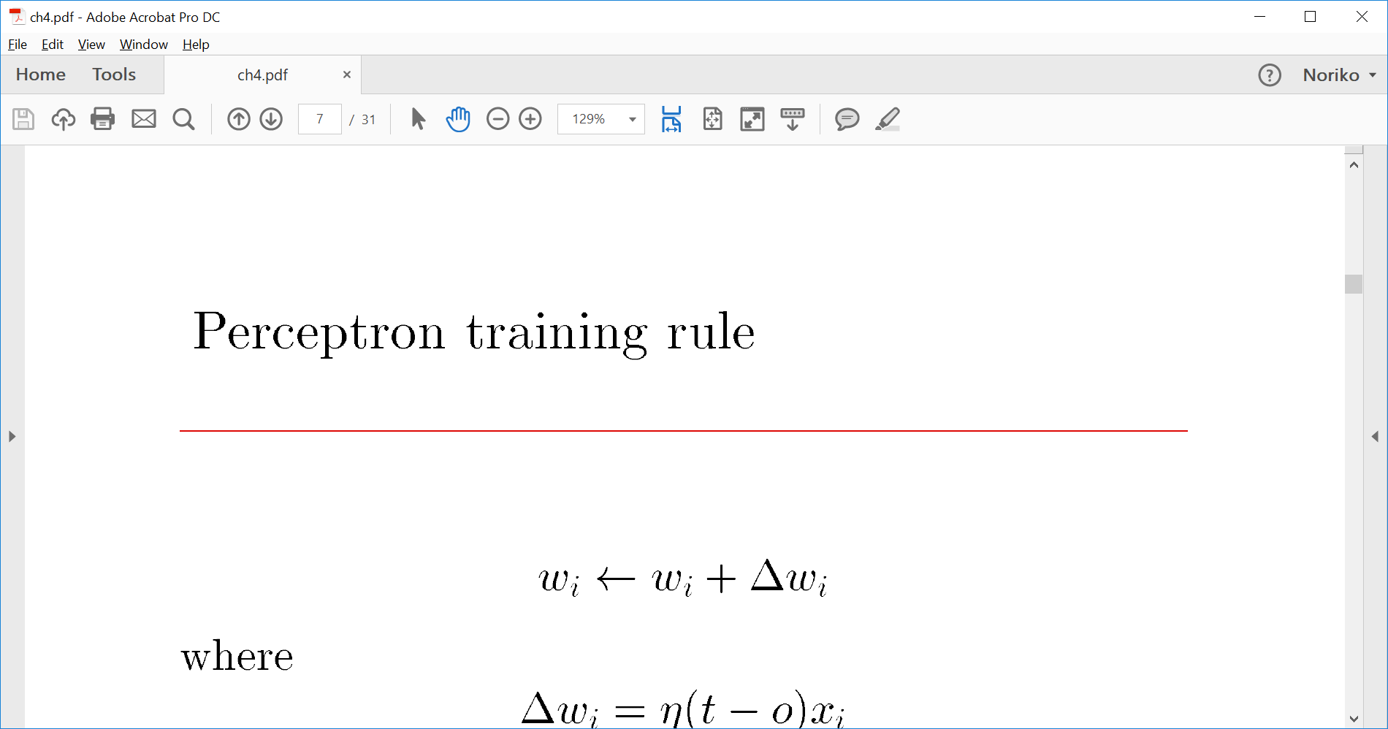
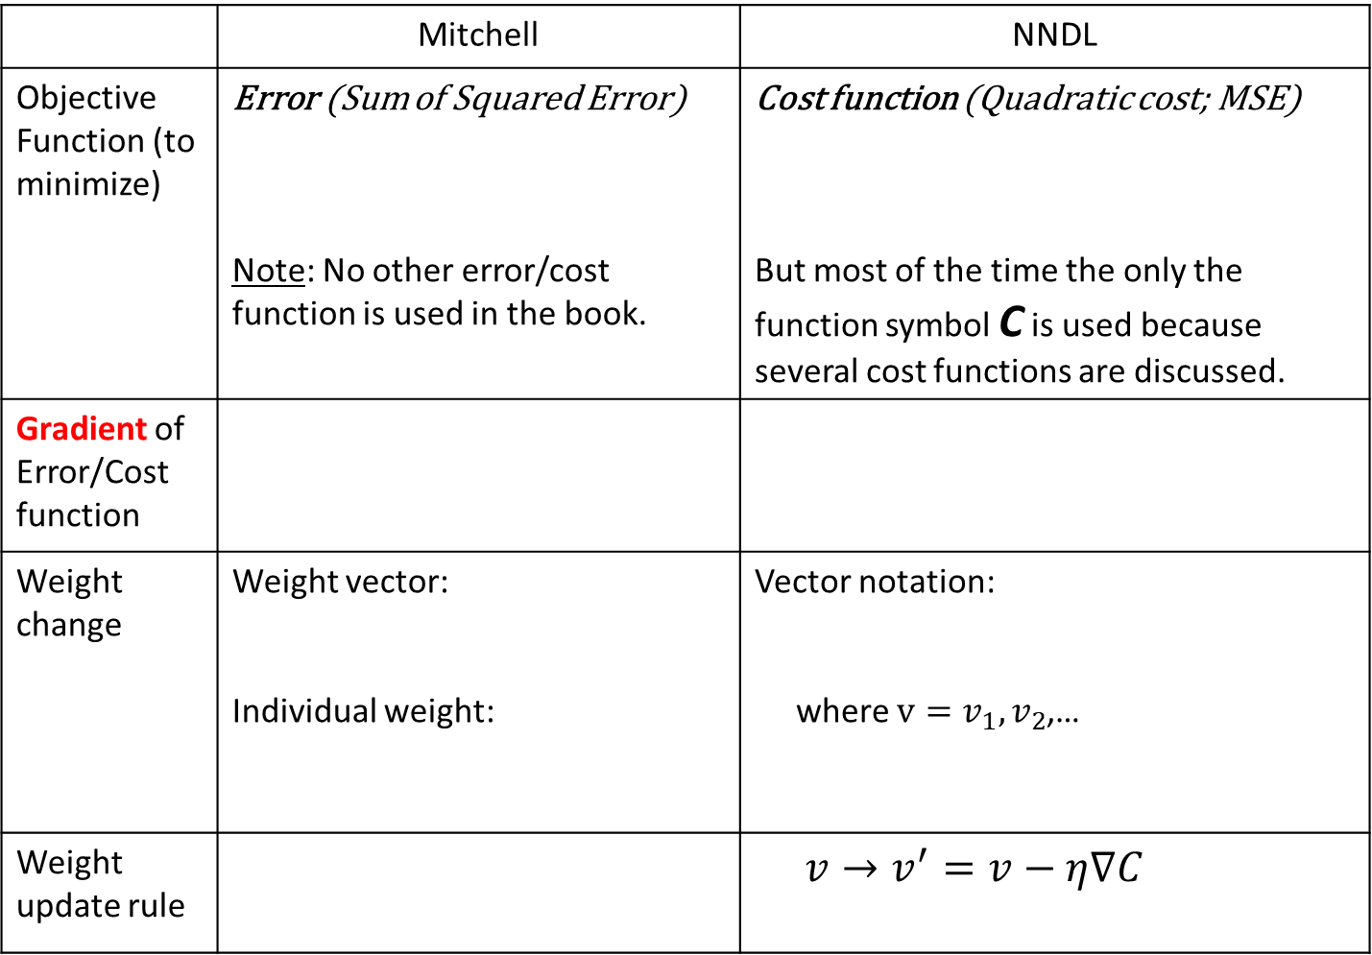
 | Mitchell | NNDL
Objective Function (to minimize) | Error (Sum of Squared Error) Note: No other error/cost function is used in the book. | Cost function (Quadratic cost; MSE) But most of the time the only the function symbol C is used because several cost functions are discussed.
Gradient of Error/Cost function
Weight change | Weight vector: Individual weight: | Vector notation: where $v=v_{1},v_{2}$,…
Weight update rule |  | $v→v^{′}=v−η∇C$

Slide 5
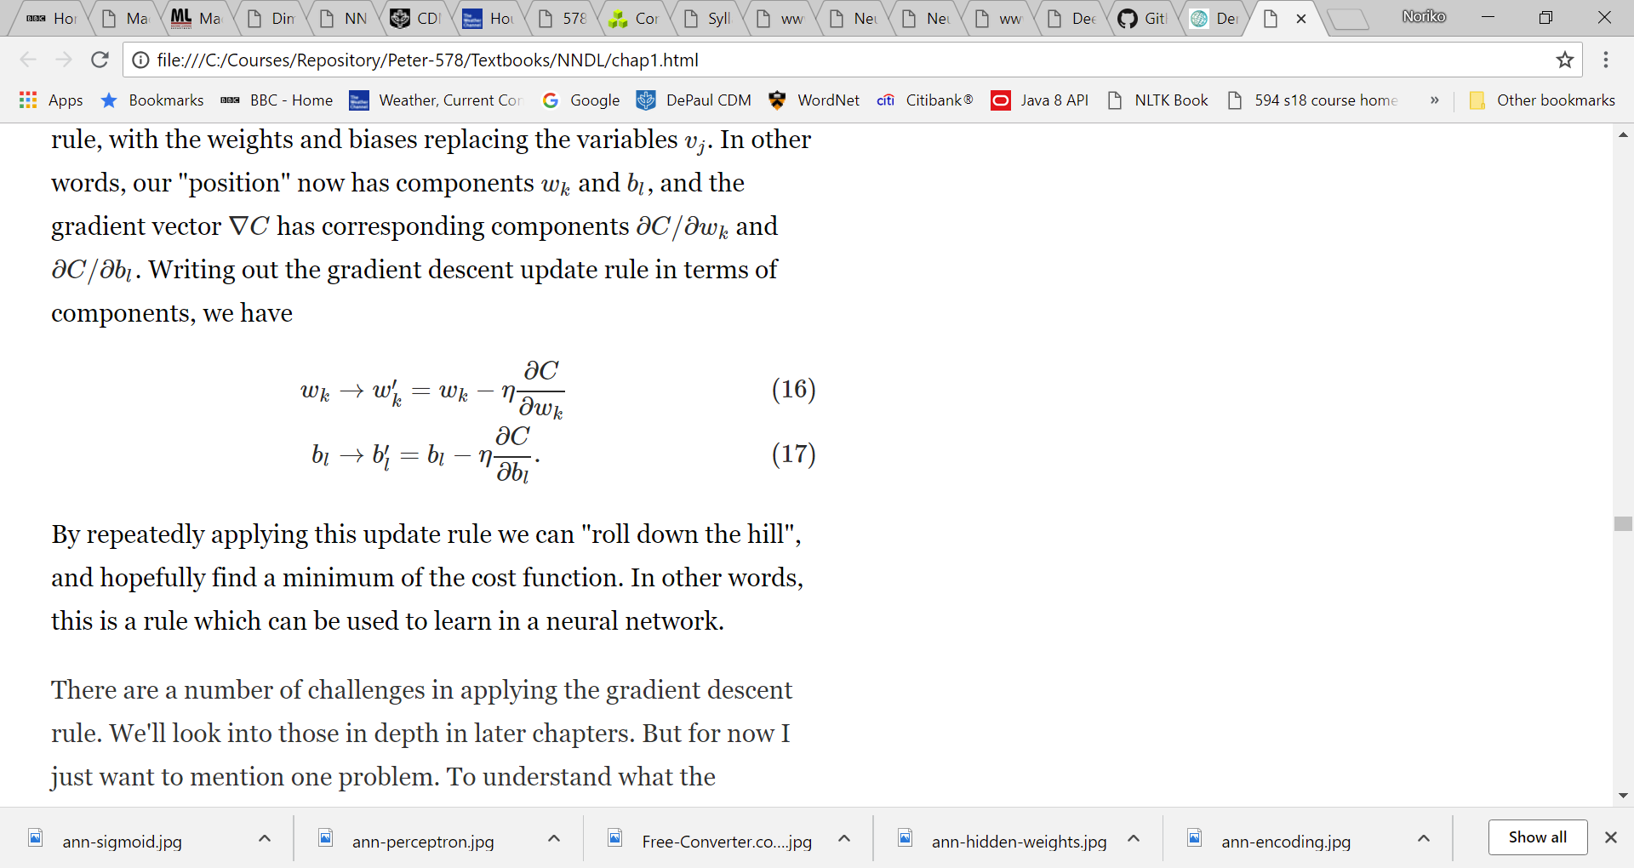
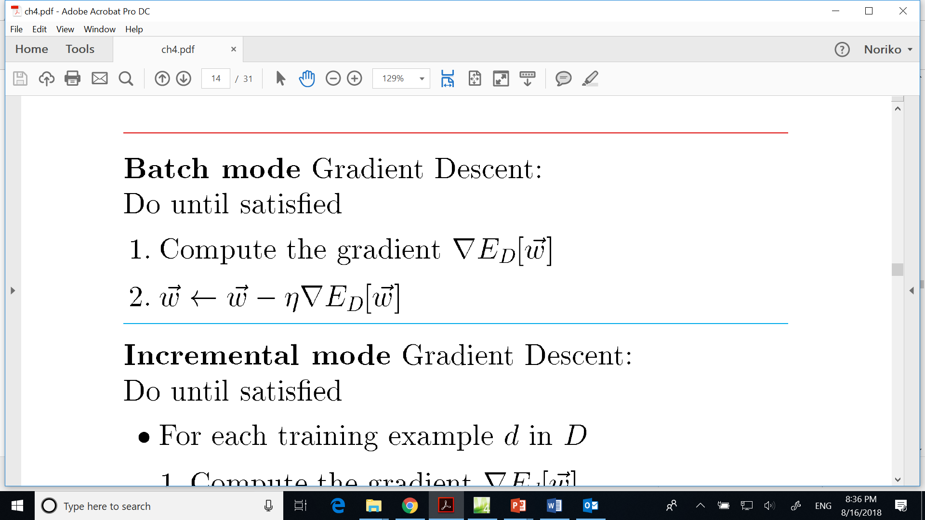
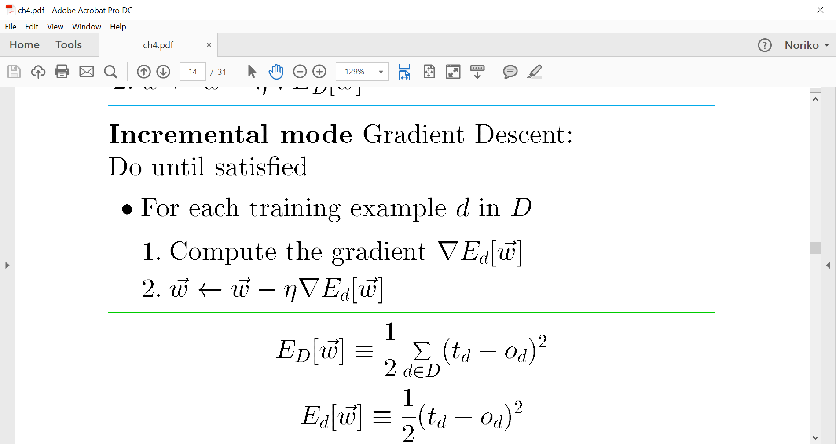
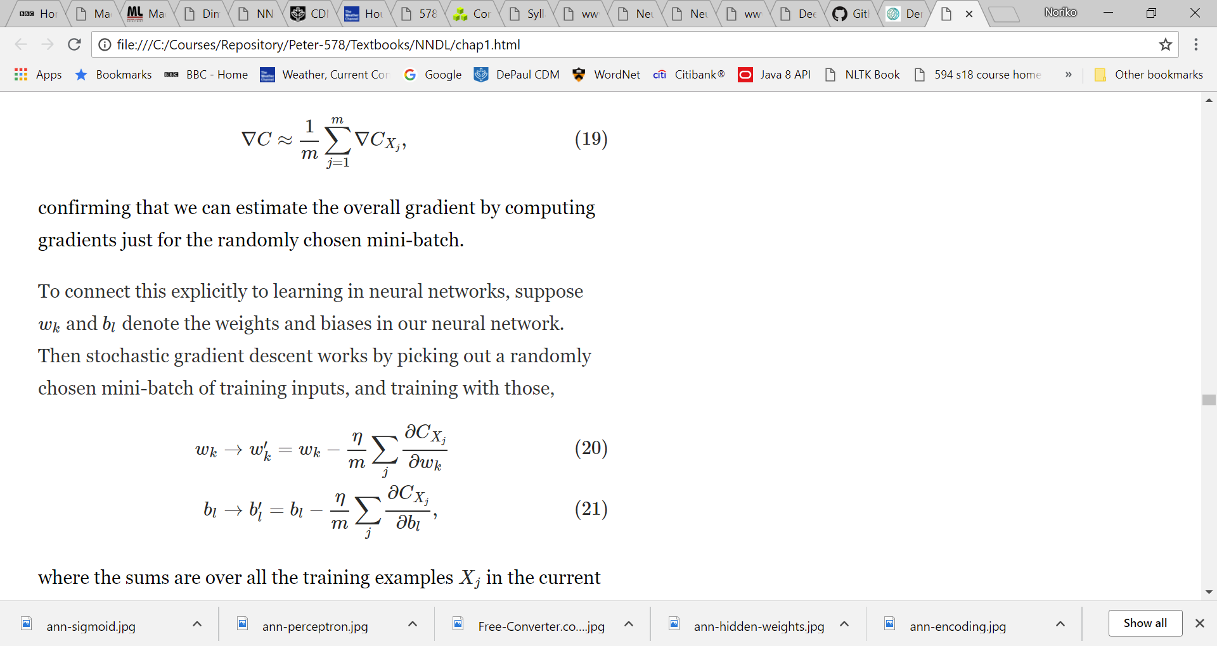
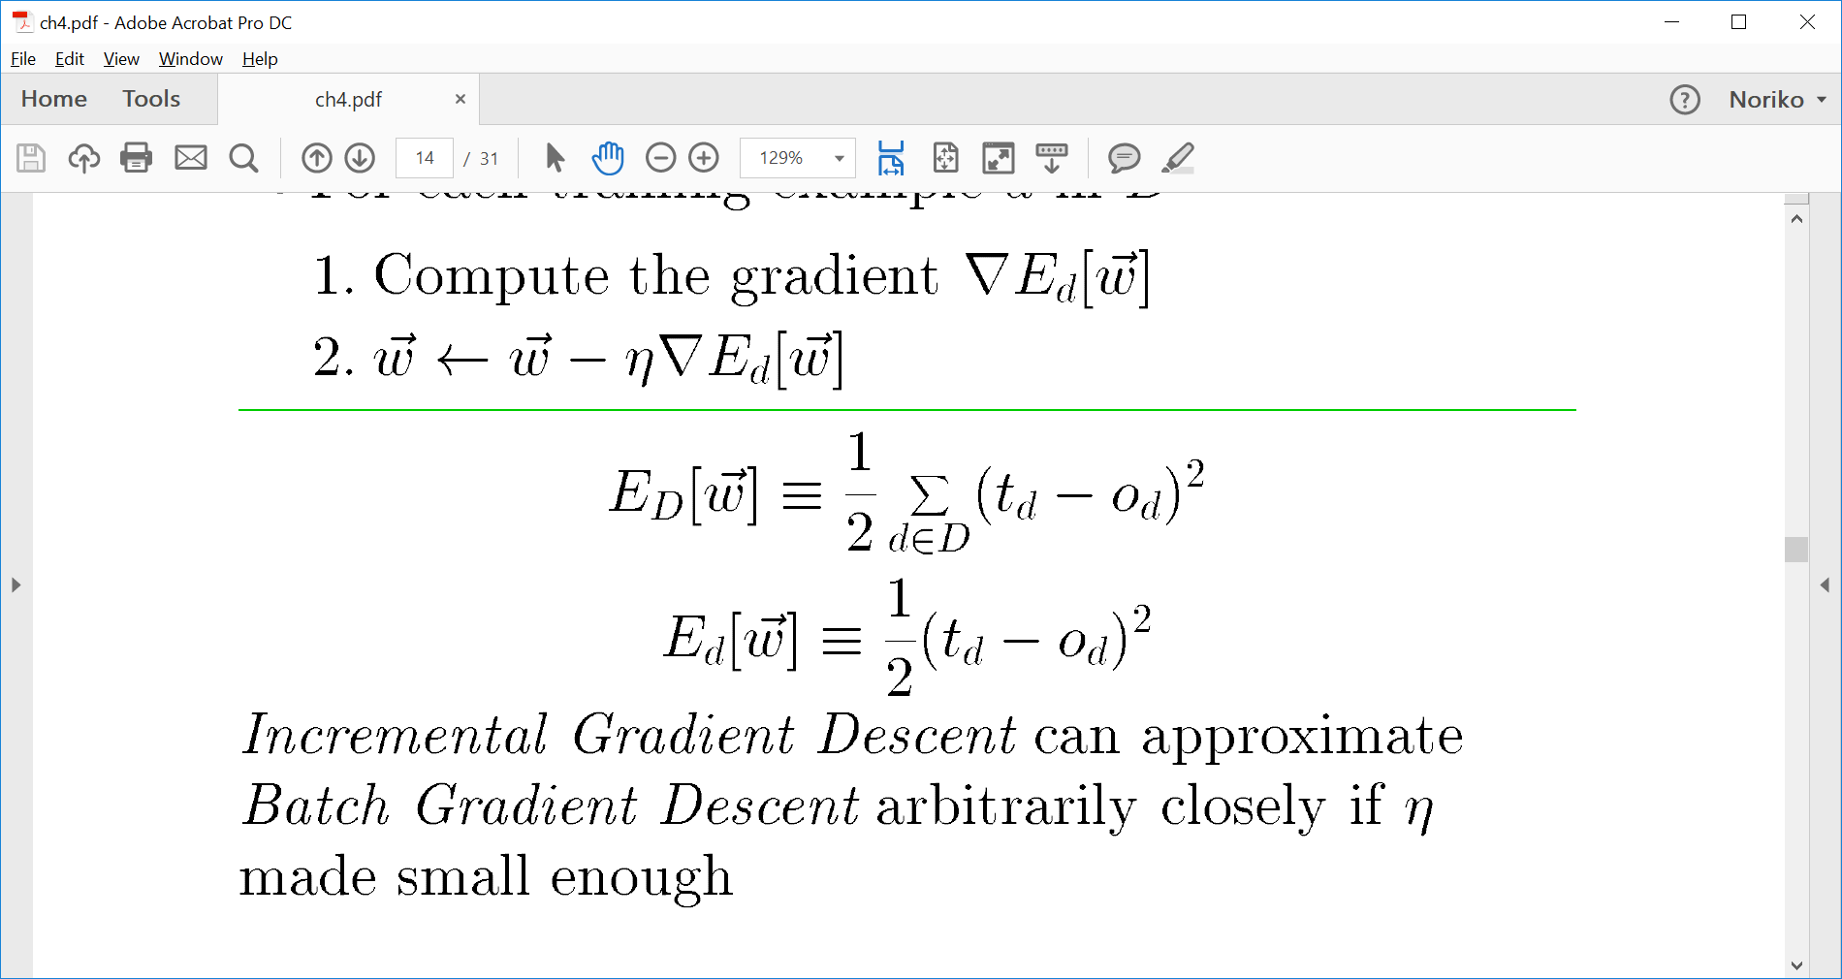
 | Mitchell | NNDL
Weight Update: batch vs. stochastic | Batch: Stochastic/ Online: where | Batch: Mini-batch/ stochastic:

Slide 6
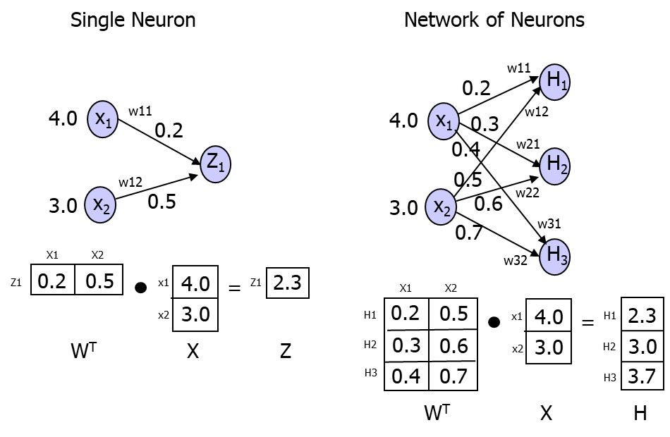
Vector Notation and Multilayer Networks

Slide 7
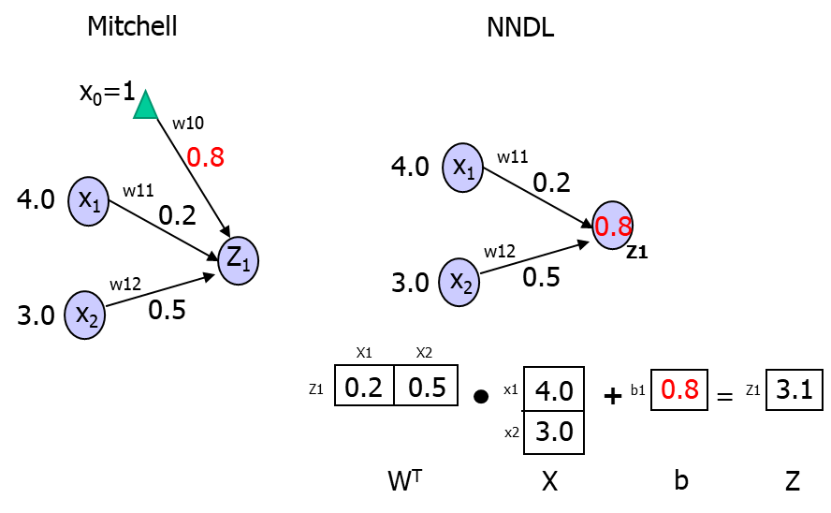
Bias – in a single neuron

Slide 8
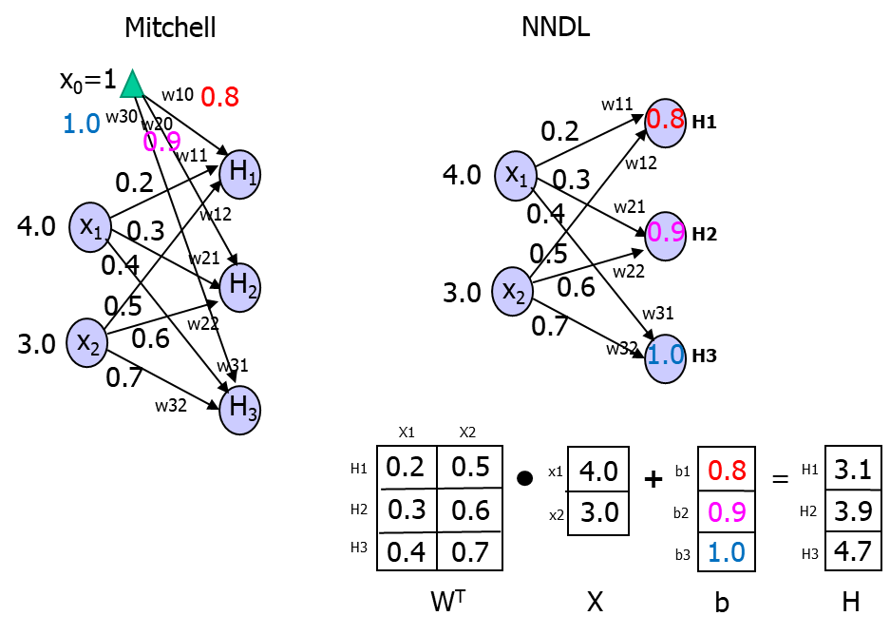
Bias – in a network of neurons

Slide 9
2. The Backpropagation Algorithm
The Backpropagation algorithm (BP) finds/learns network weights so as to minimize the network error (cost function) by iteratively adjusting the weights.
Iterative weight updates is done by ‘rolling down’ the error surface (to the minimum point).
Gradient descent algorithm is used for the procedure.
BP applies to networks with any number of layers (i.e., multi-layer neural networks).
Error at the output layer is propagated back to the hidden layers, so as to adjust the weights between the hidden layers (as well as the weights connected to the output layer).

Slide 10
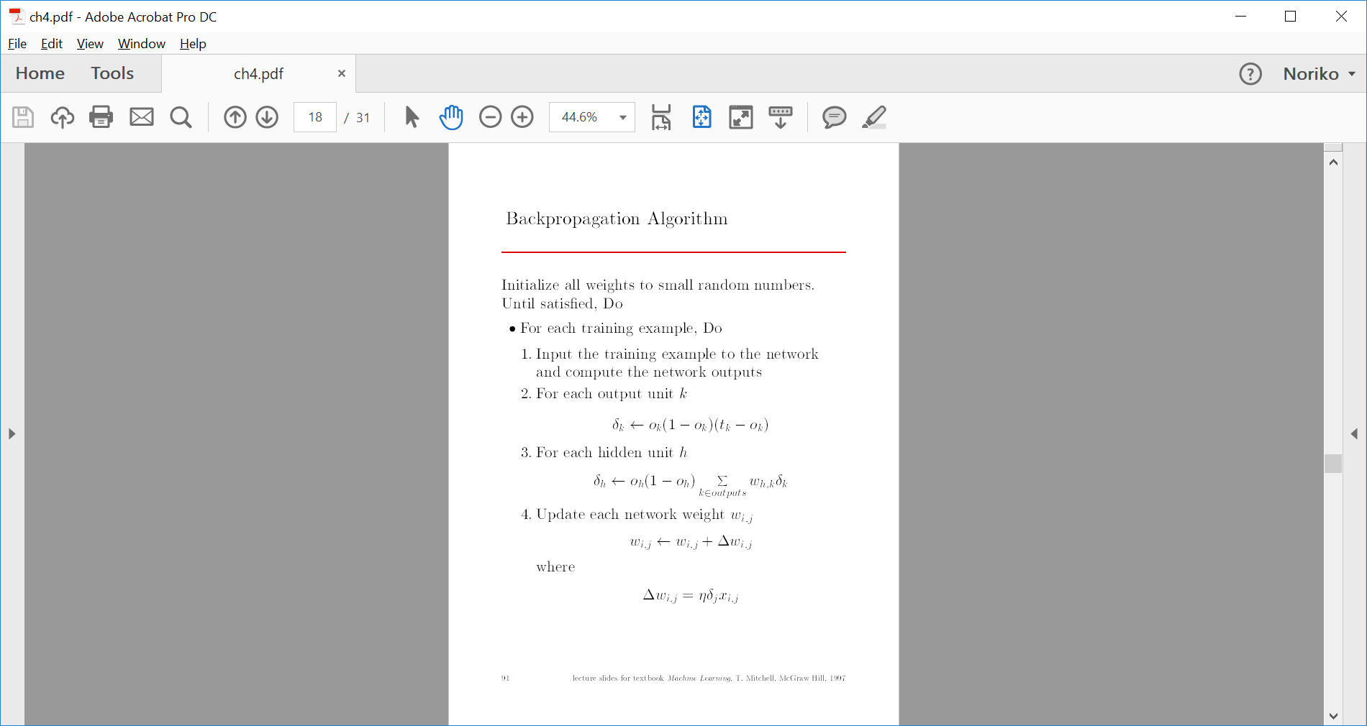
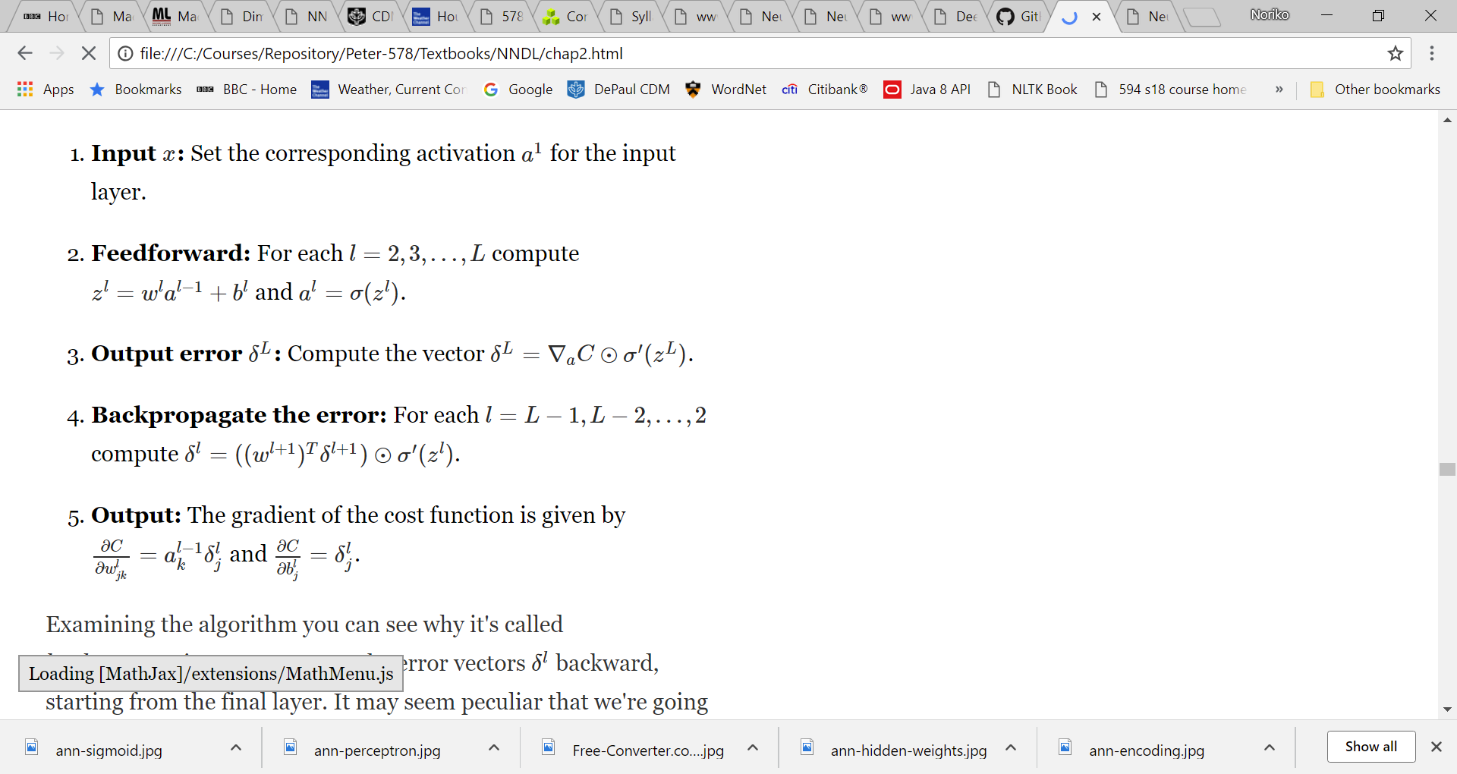
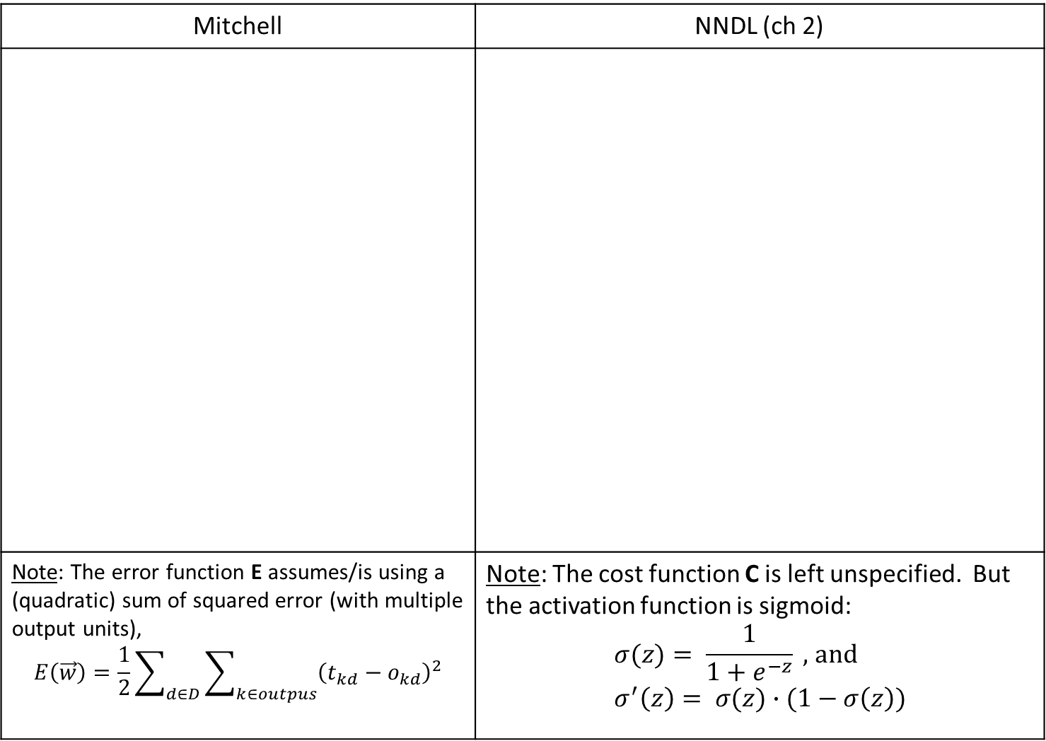
Mitchell | NNDL (ch 2)
Note: The error function E assumes/is using a (quadratic) sum of squared error (with multiple output units), $$E\left(\vec{w}\right)=\frac{1}{2}\sum_{d∈D}{\sum_{k∈outpus}{{\left(t_{kd}−o_{kd}\right)}^{2}}}$$ | Note: The cost function C is left unspecified. But the activation function is sigmoid: $$σ(z)= \frac{1}{1+e^{−z}} \text{, }\text{and} \\ σ^{′}\left(z\right)= σ(z)∙(1−σ\left(z\right))$$

Slide 11
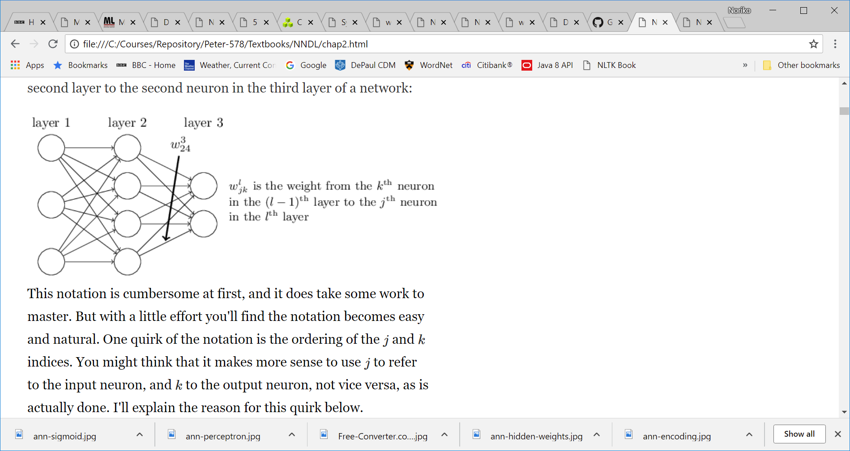
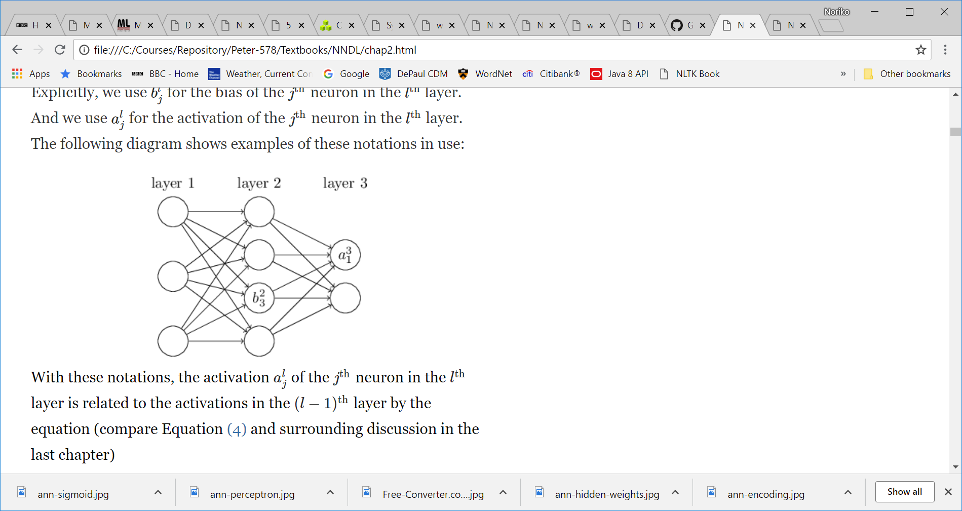
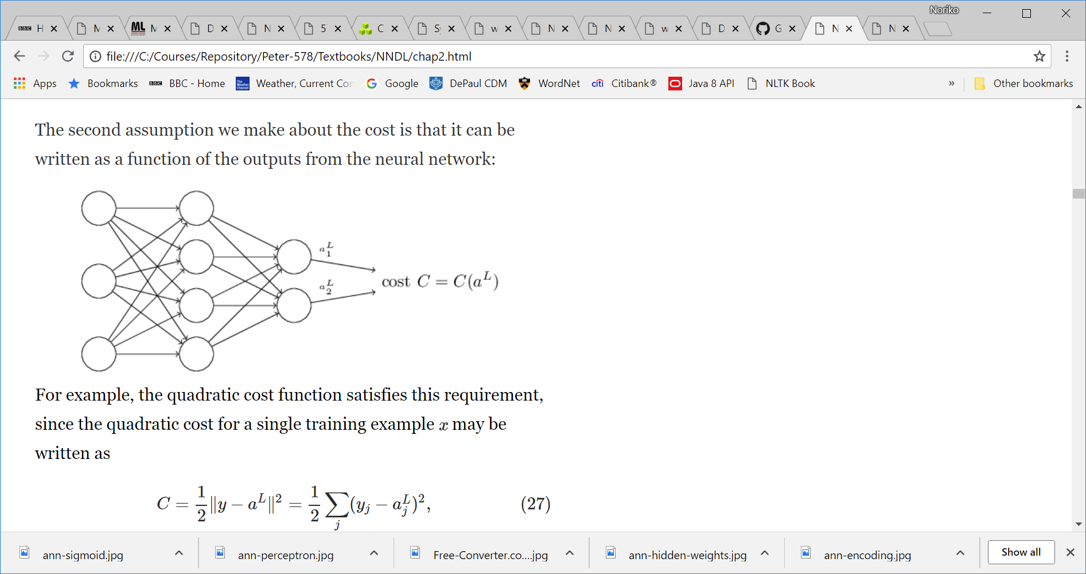
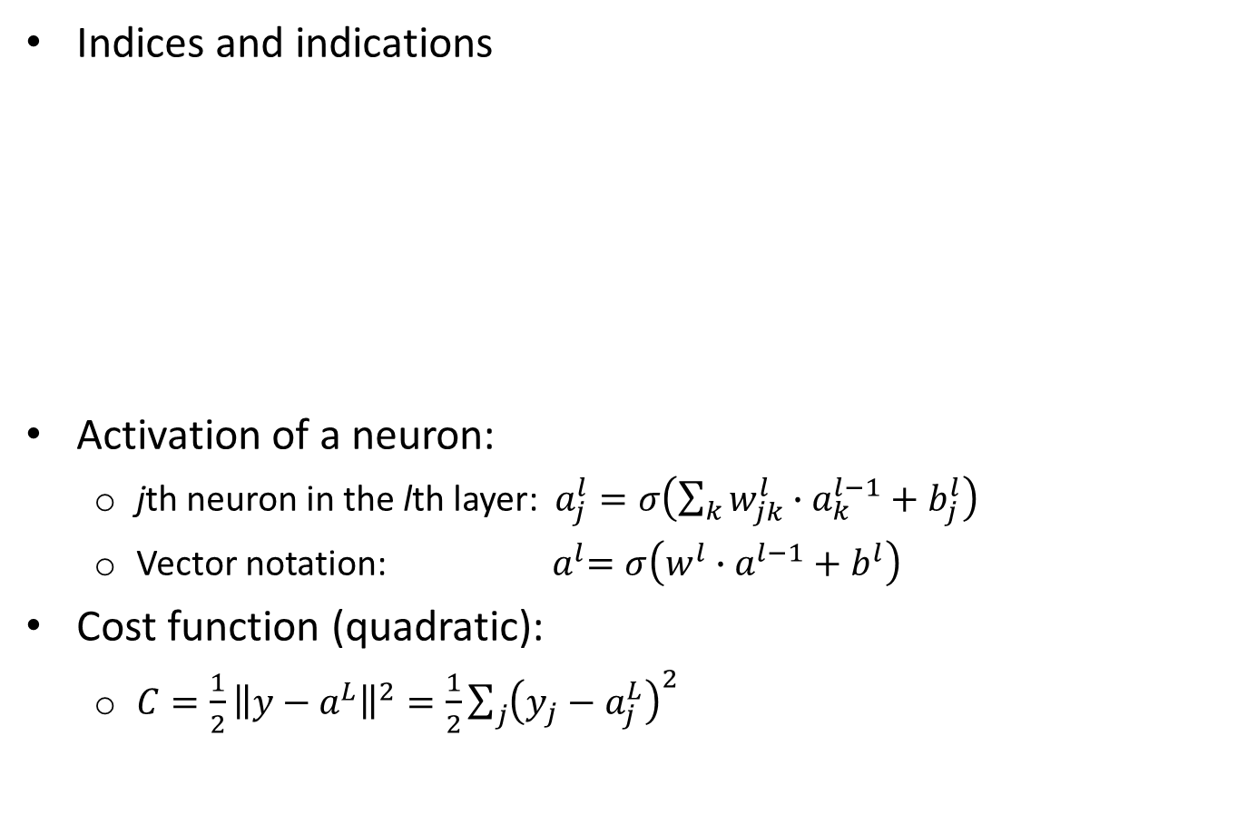
Notations in the NNDL BP Algorithm (ch 2)
Indices and indications
Activation of a neuron:
jth neuron in the lth layer: $a_{j}^{l}=σ\left(\sum_{k}{w_{jk}^{l}∙a_{k}^{l−1}+b_{j}^{l}}\right)$
Vector notation: ${ a}^{l}=σ\left(w^{l}∙a^{l−1}+b^{l}\right)$
Cost function (quadratic):
$C=\frac{1}{2}{\left\|y−a^{L}\right\|}^{2}=\frac{1}{2}\sum_{j}{{\left(y_{j}−a_{j}^{L}\right)}^{2}}$

Slide 12
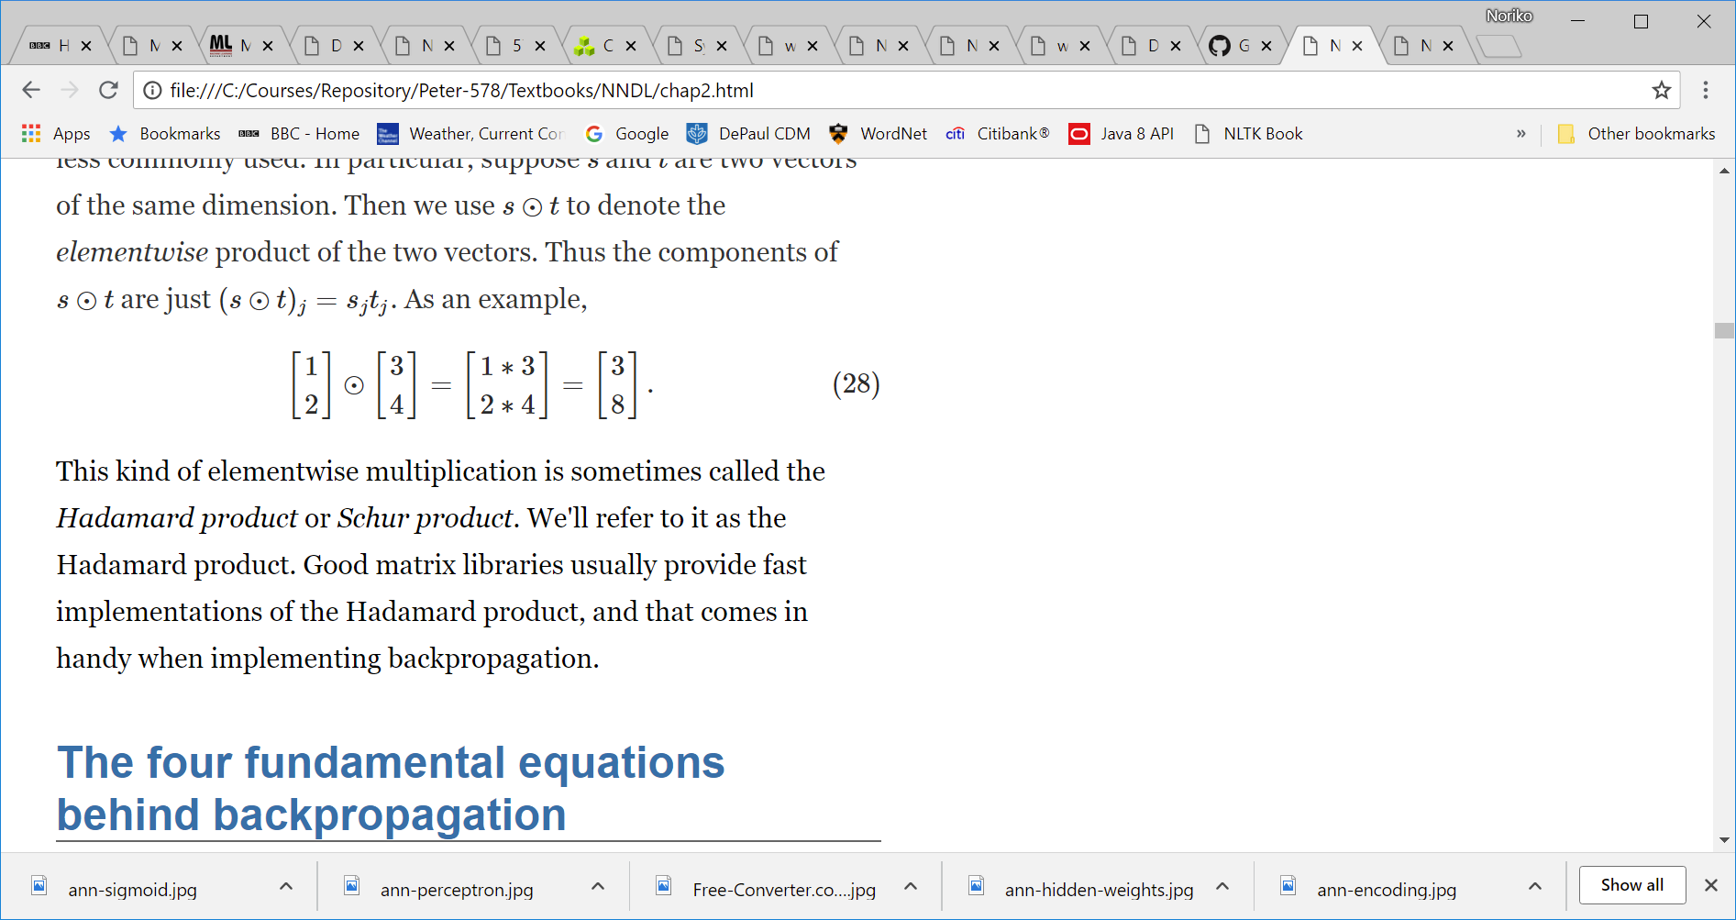
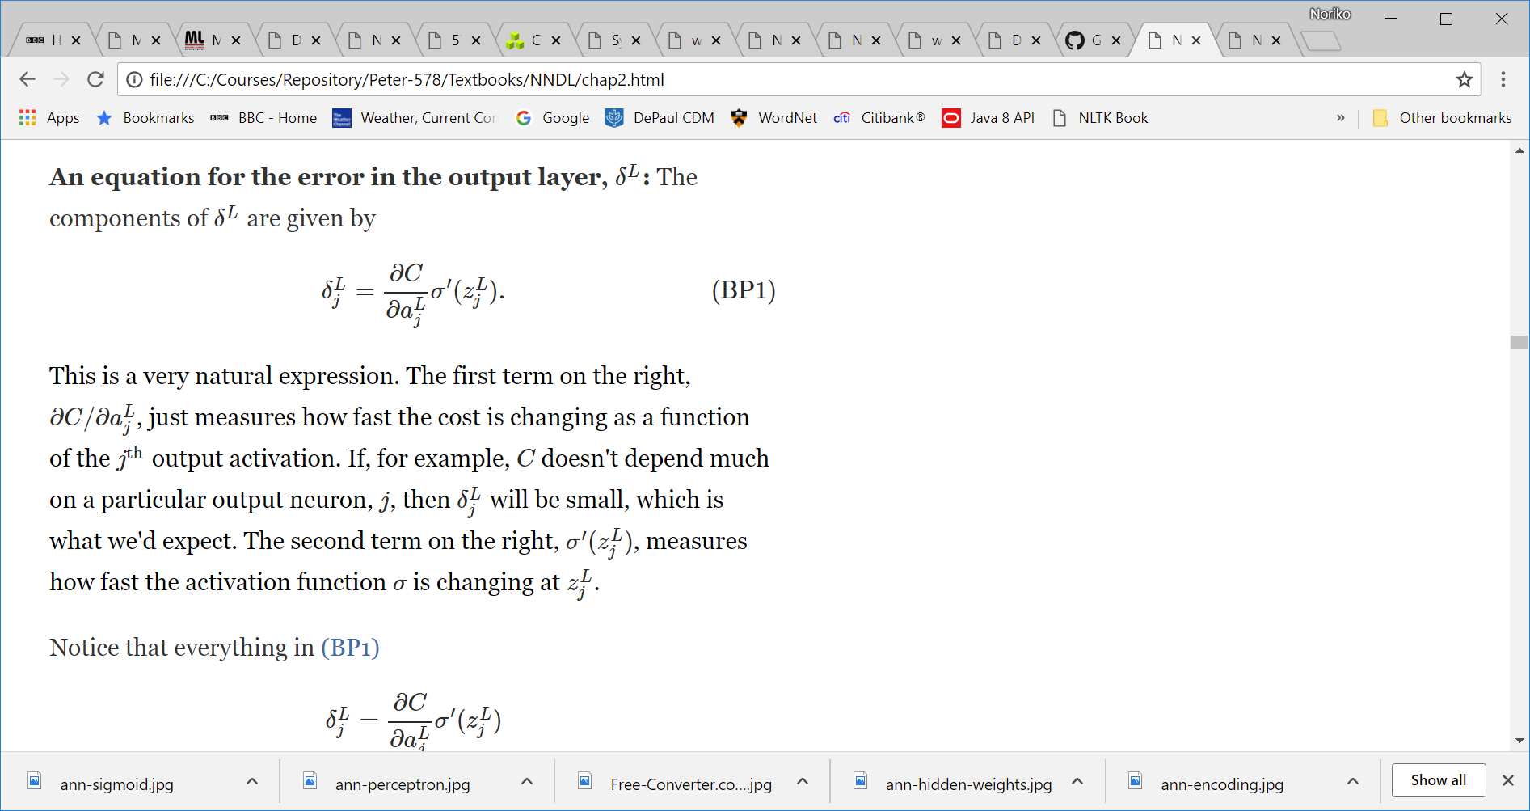
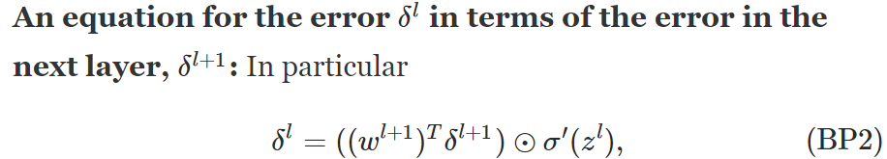
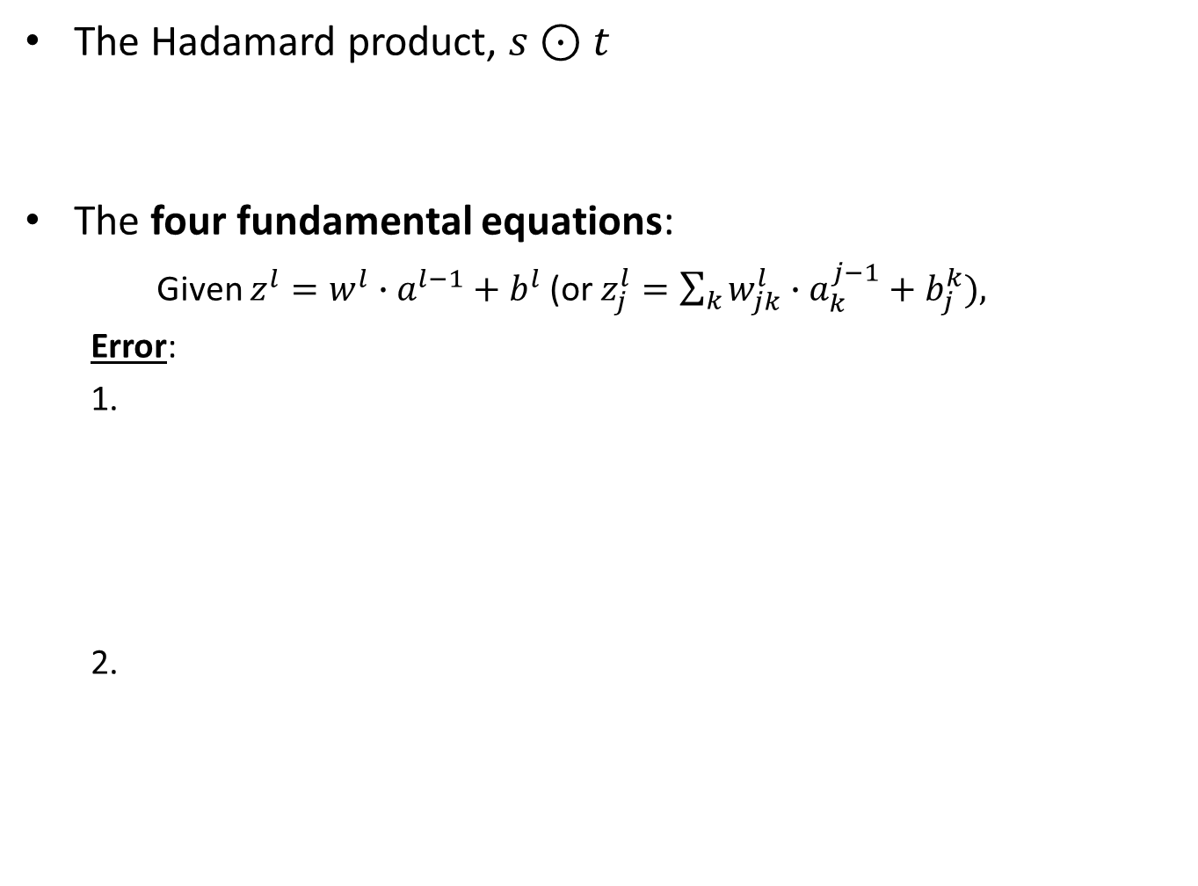
The Hadamard product, $s⊙t$
The four fundamental equations:
Given $z^{l}=w^{l}∙a^{l−1}+b^{l}$ (or $z_{j}^{l}=\sum_{k}{w_{jk}^{l}∙a_{k}^{j−1}+b_{j}^{k}}),$
Error:
2.

Slide 13
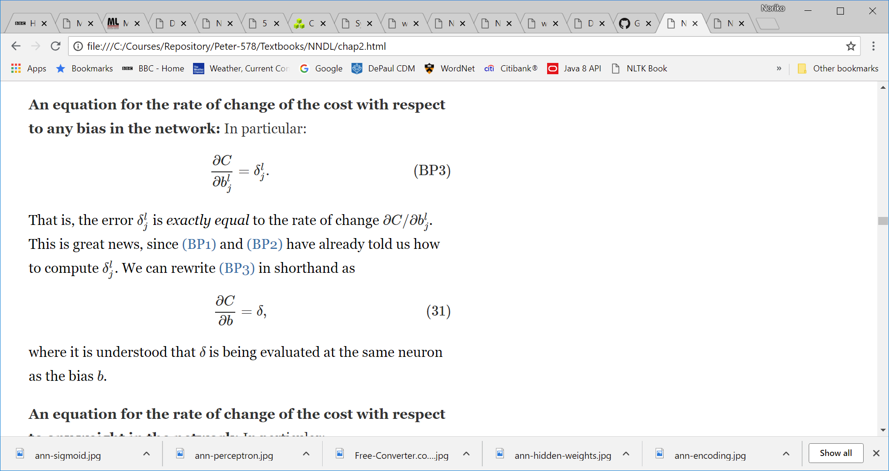
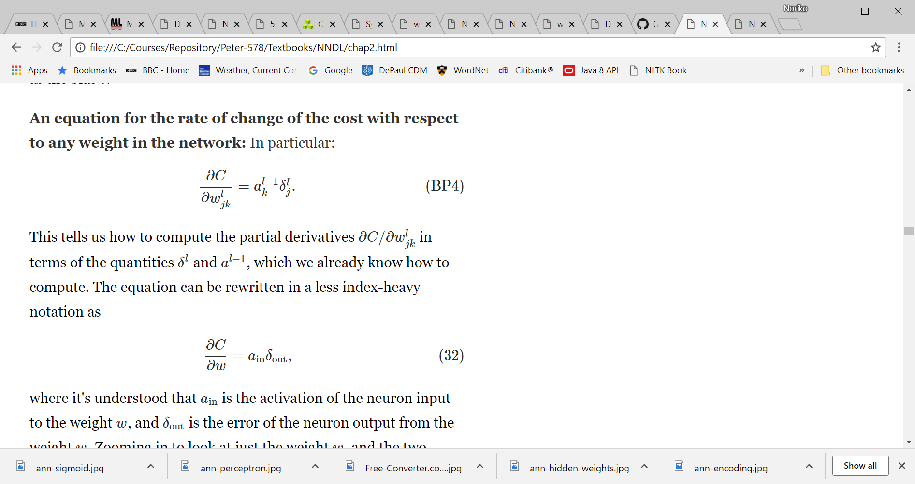
Rate of change of the cost:

Slide 14
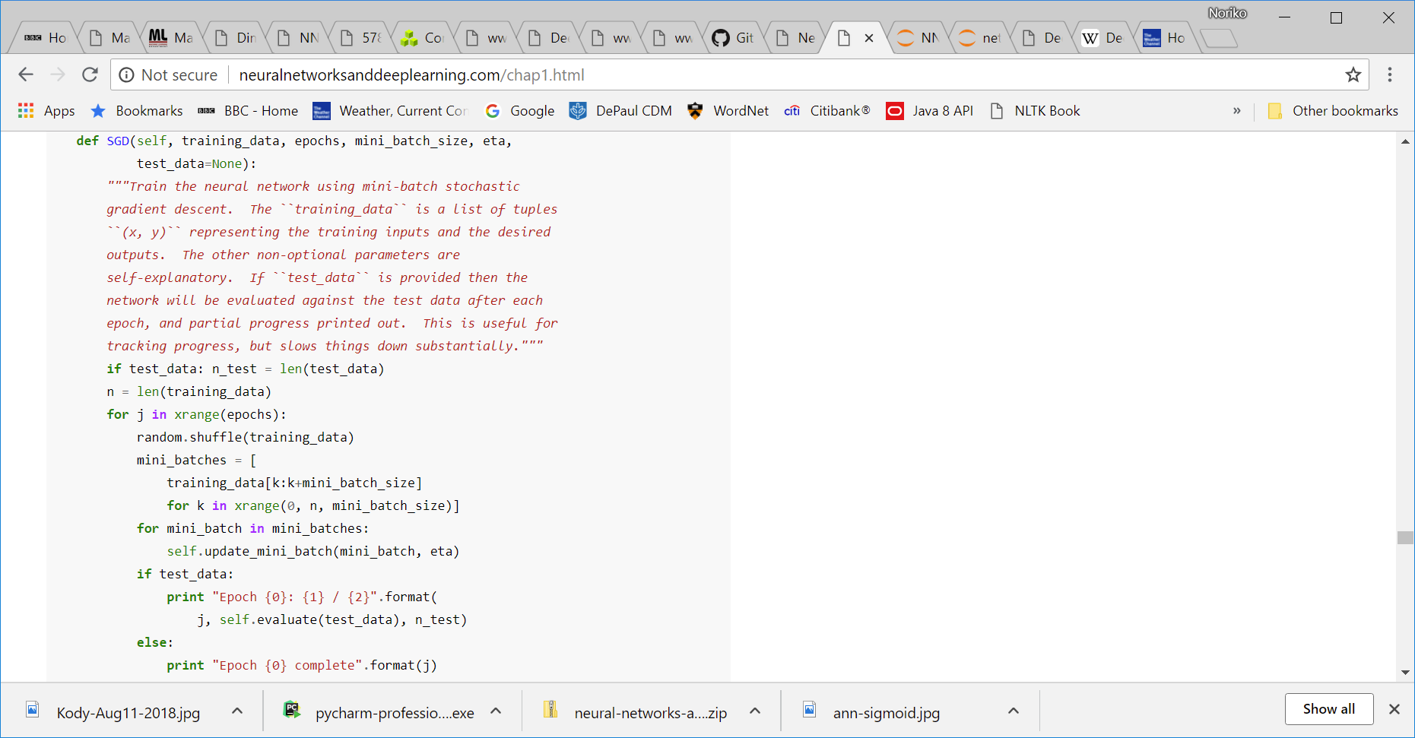
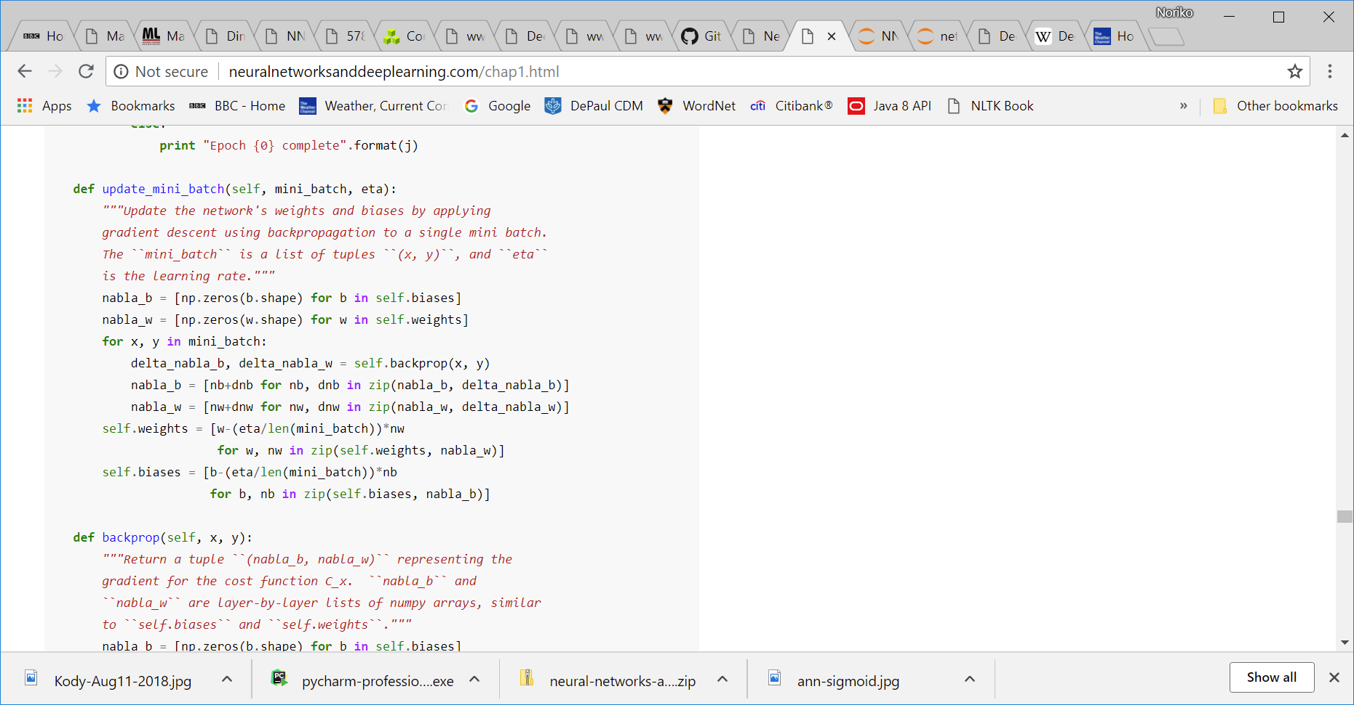
NNDL BP Code
>>> import network
>>> net = network.Network([784, 30, 10])
>>> net.SGD(training_data, 30, 10, 3.0, test_data=test_data)

Slide 15
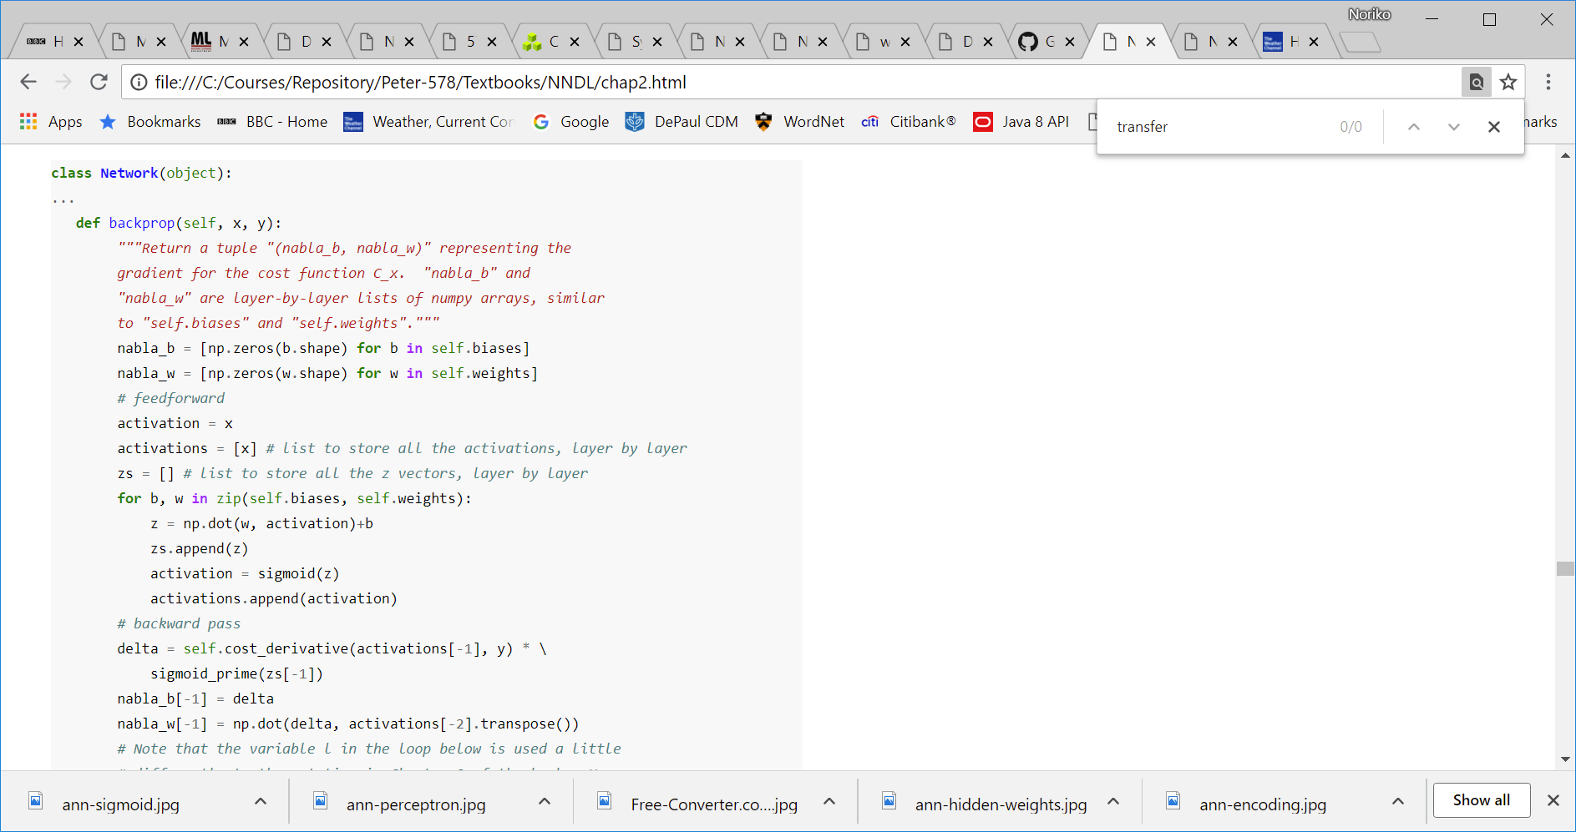
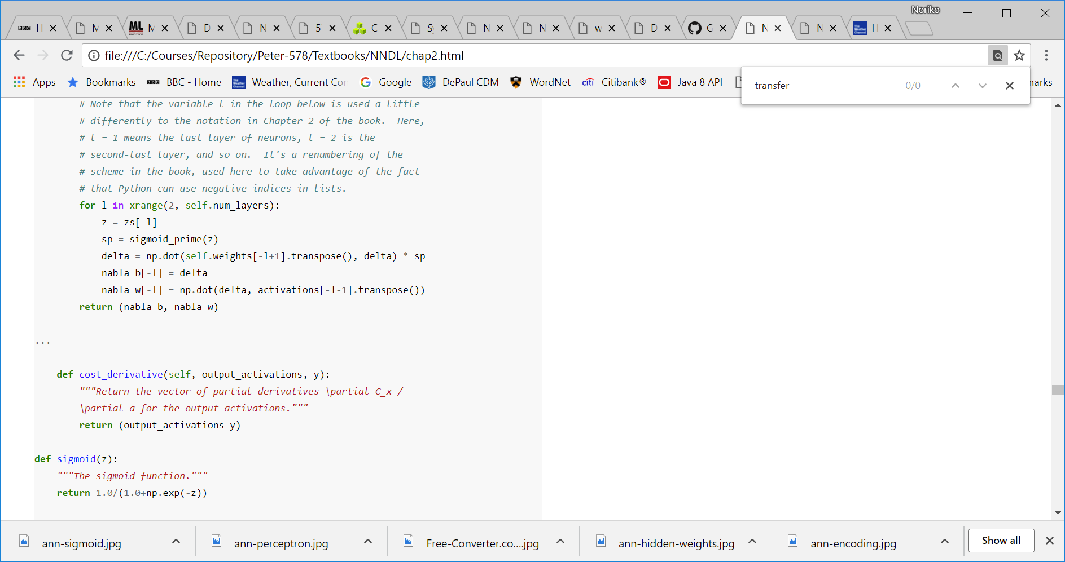
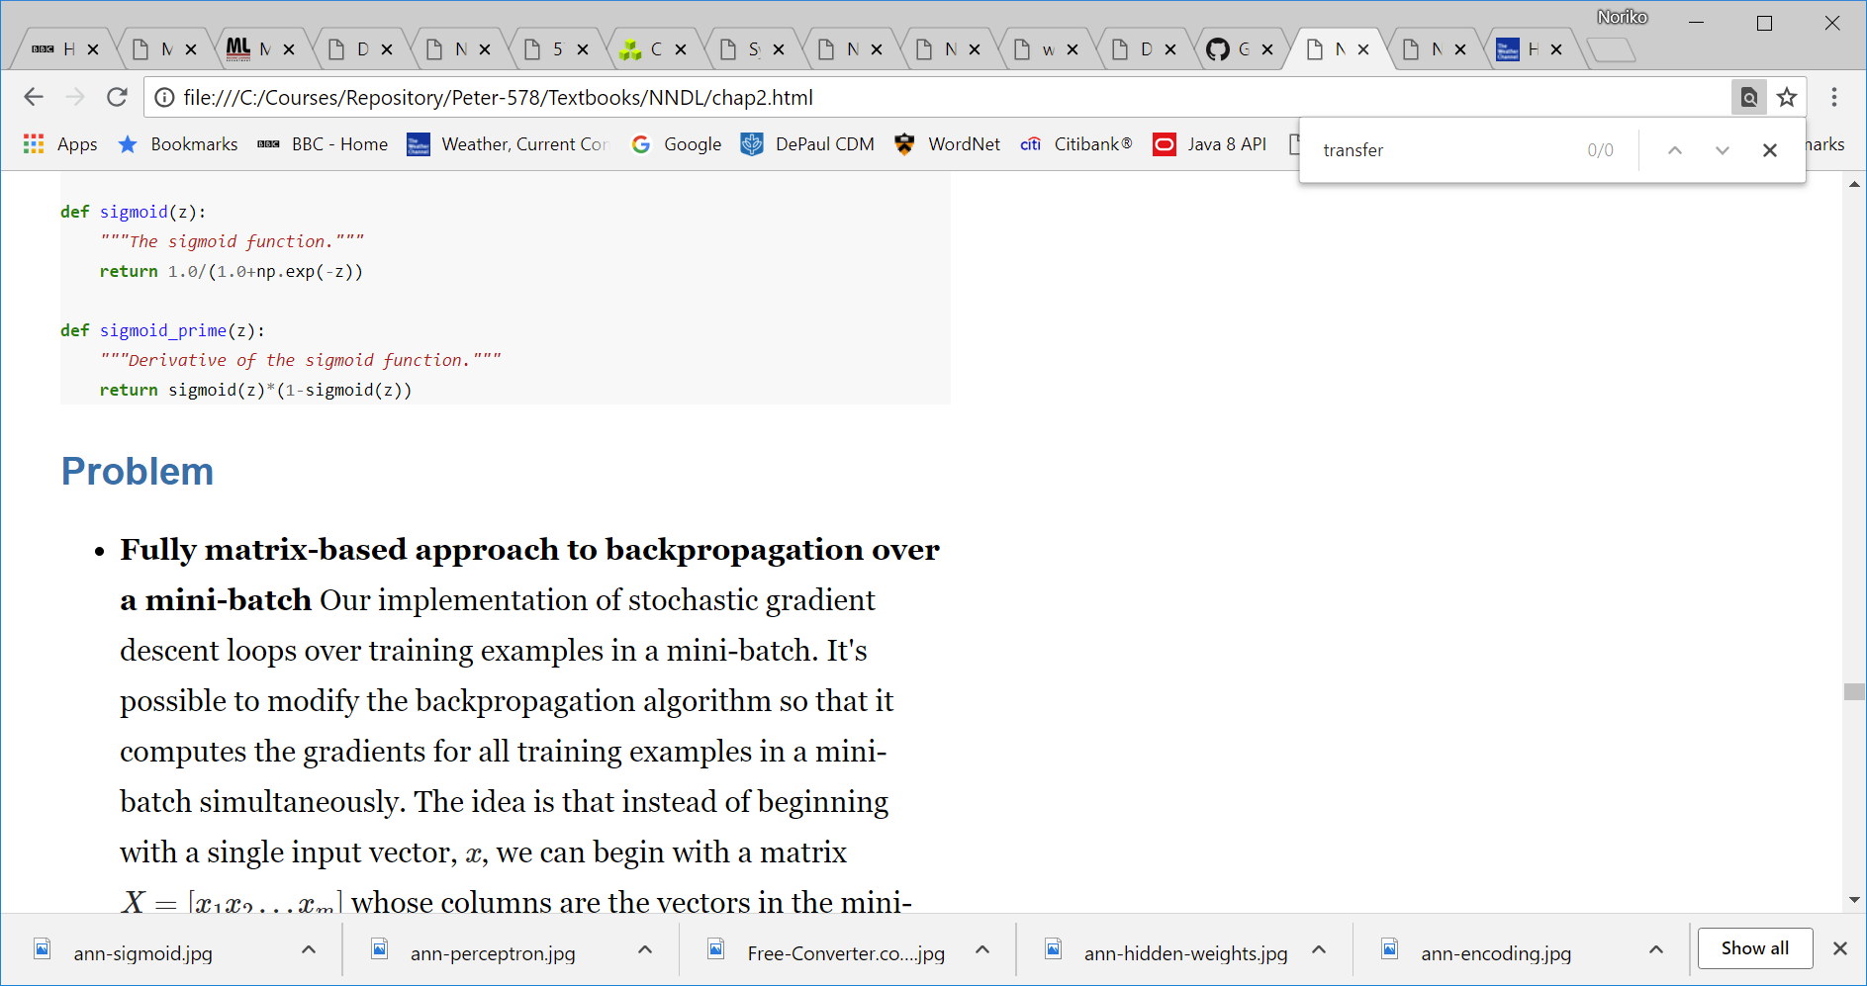
NNDL BP Code

